Slide 1
How God Gives
James 1:1-12

Slide 2
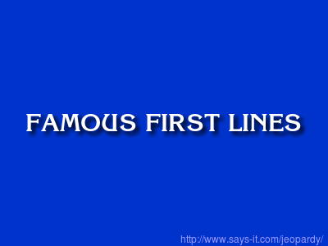

Slide 3
Salutation (v.1)
Joy (v.2)
Steadfastness ? (v.3)
Perfection ? (v.4)
Wisdom ? (v.5)
Faith ? (v.6)
Double-mindedness ? (v.7-8)
Rich vs. Poor ? (v.9-11)
Crown of Life ? (v.12)

Slide 4
Background
“James, a servant of God and of the Lord Jesus Christ…”
  Most likely “James the Just”, the (half-)brother of Jesus
  Pastored the Church at Jerusalem

Slide 5
Background
“To the Twelve Tribes in the Dispersion…”
  Eschatological (“end times”) themes
    Mat. 19:28, Lk. 22:30, Acts 26:7, Rev. 21:12

Slide 6
One Core Message
“Trials” and “perseverance” are at the beginning and end of the passage.
This genre of literature is epistolary (i.e. a letter)

Slide 7
The Rich and the Poor
“⁹ Let the lowly brother boast in his exaltation, ¹⁰ and the rich in his humiliation, because like a flower of the grass he will pass away. ¹¹ For the sun rises with its scorching heat and withers the grass; its flower falls, and its beauty perishes. So also will the rich man fade away in the midst of his pursuits.” (ESV)

Slide 8
The Poor Man
WISDOM helps to PERSEVERE through the TRIAL by seeing above and beyond it.

Slide 9
The Rich Man
Good Example or Bad?
Losing His Money or Losing His Life?

Slide 10
The Rich Man
PERSEVERING though a TRIAL yields WISDOM

Slide 11
Faith and Doubt
FAITH and DOUBT have opposite expectations about the trial.

Slide 12
Perseverance
“³ …because you know that the testing of your faith produces perseverance. ⁴ Let perseverance finish its work so that you may be mature and complete, not lacking anything.” (NIV)

Slide 13


Slide 14
“² Count it all joy, my brothers, when you meet trials of various kinds…”
(NIV)

Slide 15
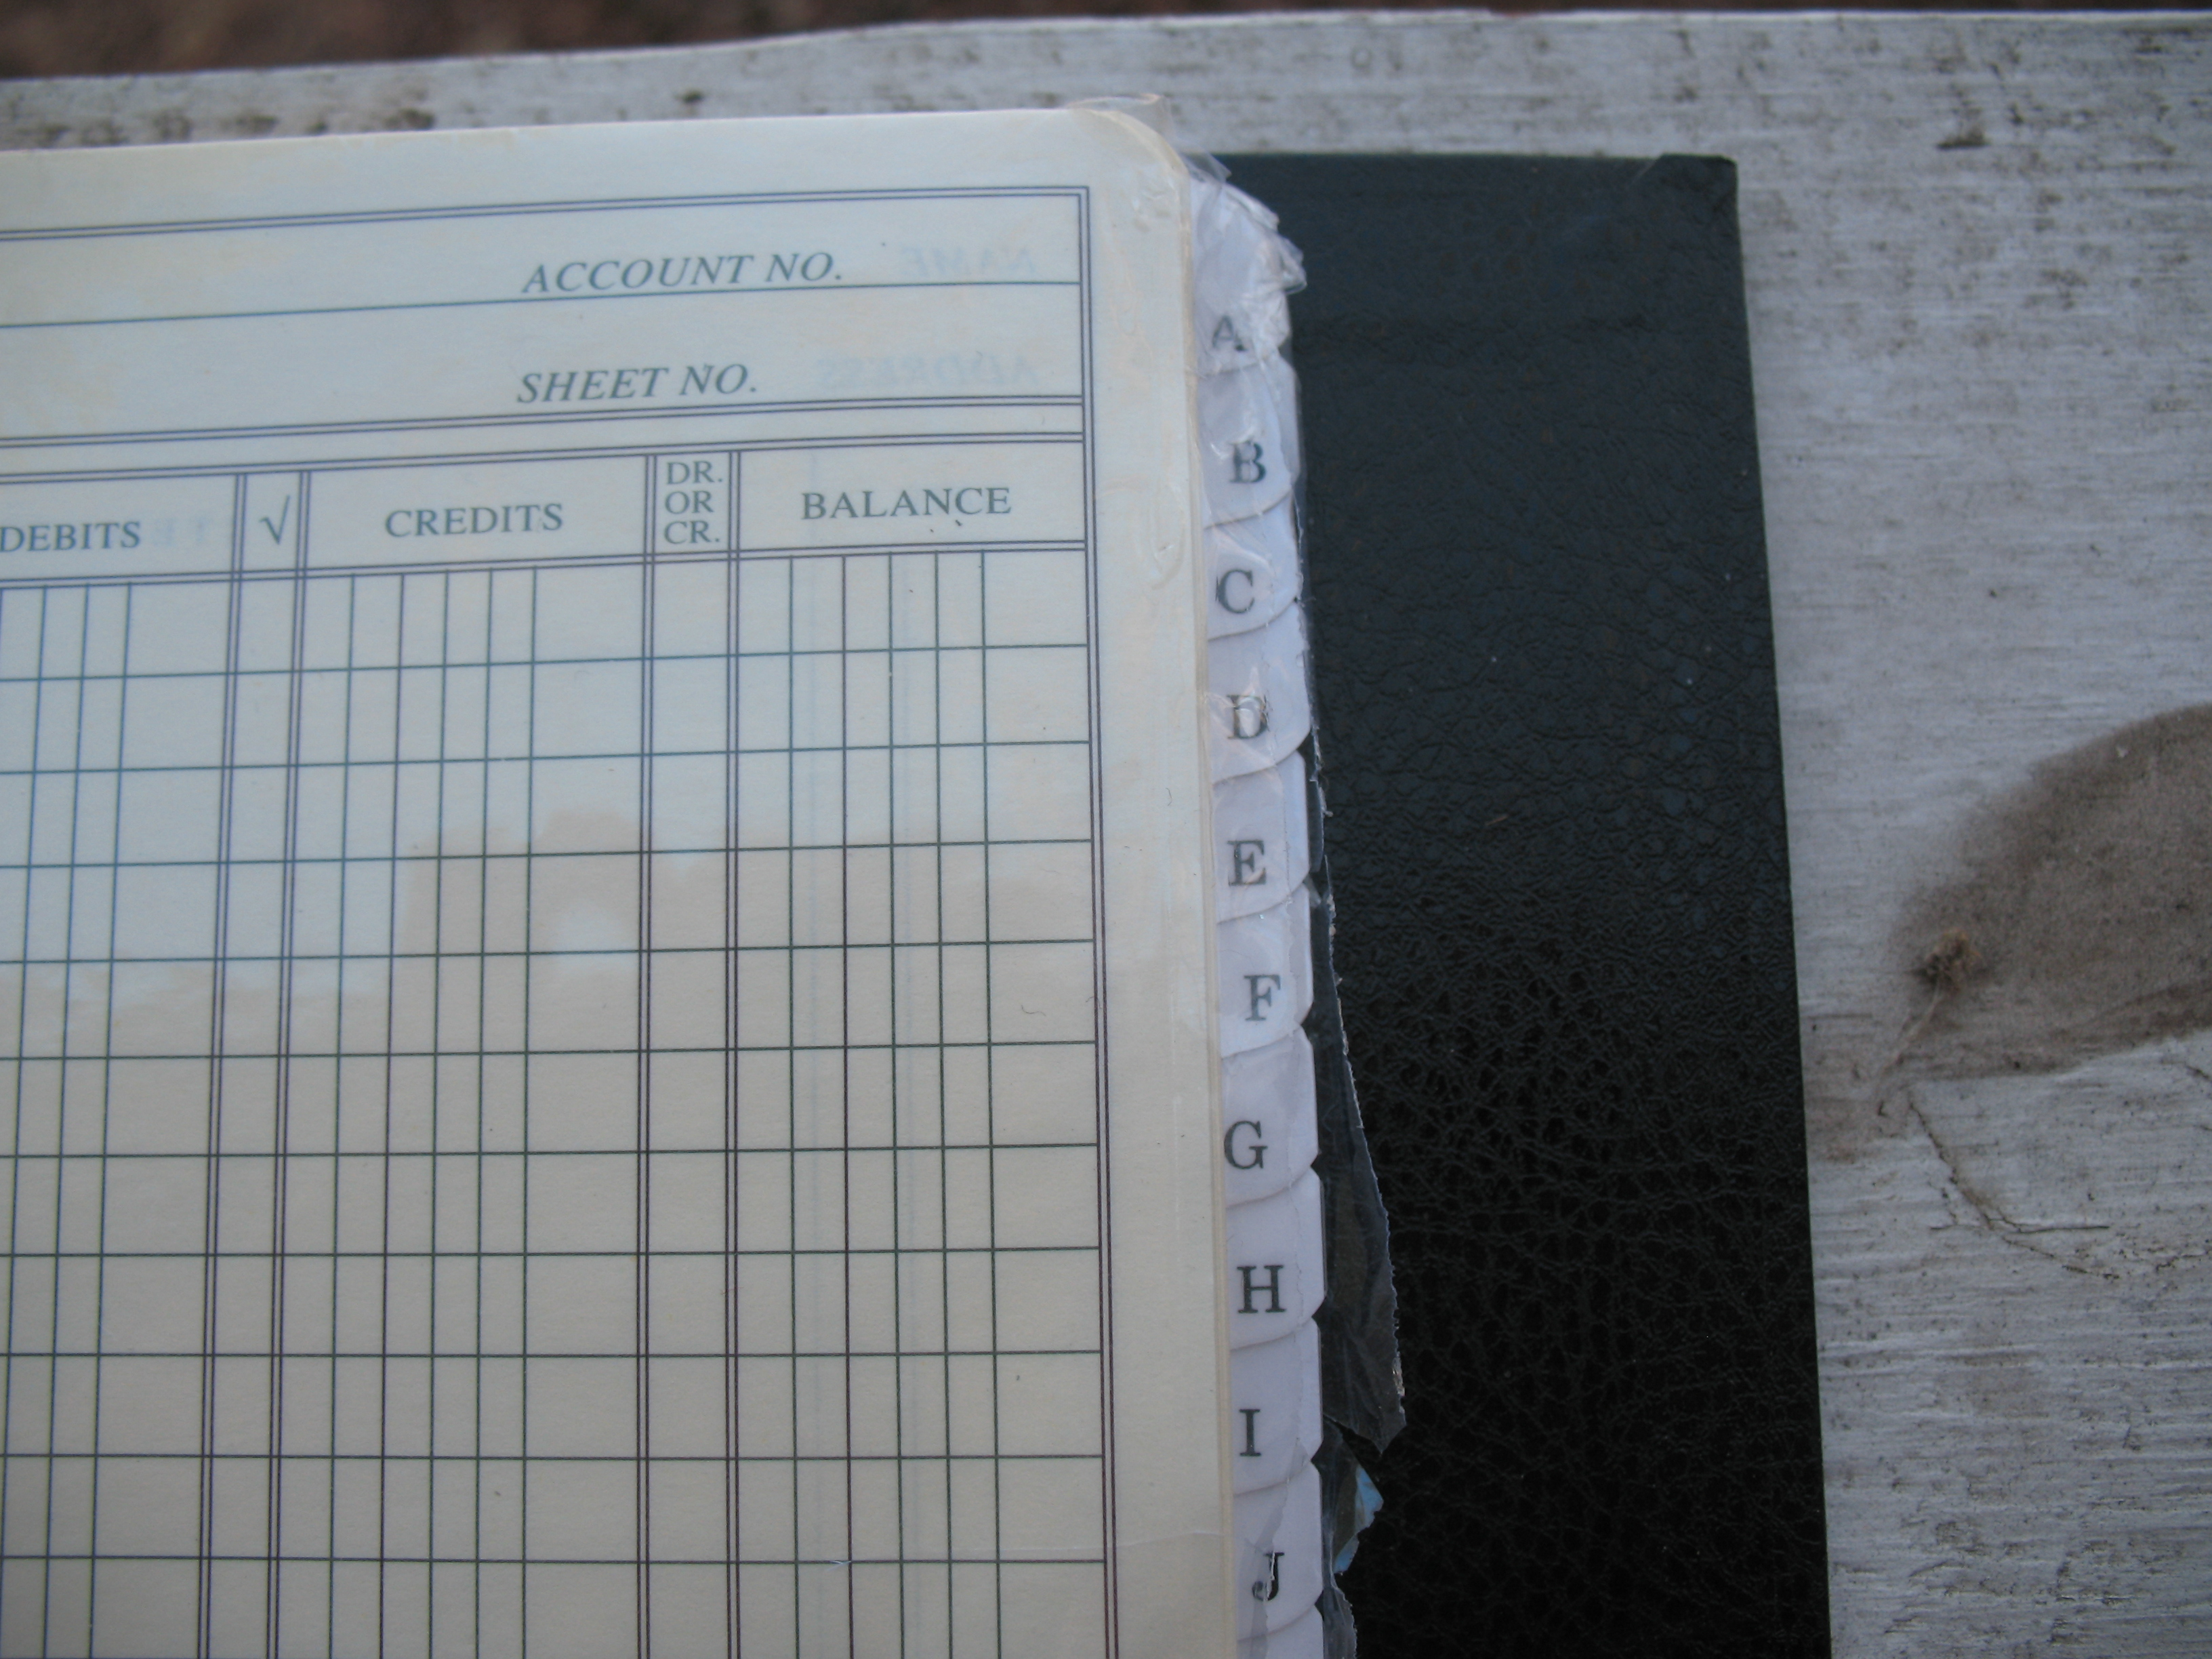

Slide 16
Application
Be assured that when you are facing a trial, God is not trying to harm you.
Understand that God gives you qualities like perseverance and wisdom through trials, and allow Him to do so (“let God into your garden”).
When you ask God for wisdom and other means of help, do not set your own expectations on how God will deliver.

Slide 17
“¹⁰ For everyone who asks receives, and the one who seeks finds, and to the one who knocks it will be opened. ¹¹ What father among you, if his son asks for a fish, will instead of a fish give him a serpent; ¹² or if he asks for an egg, will give him a scorpion? ¹³ If you then, who are evil, know how to give good gifts to your children, how much more will the heavenly Father give the Holy Spirit to those who ask him!”
Luke 11:10-13 (ESV)

Slide 18
“¹⁶ Do not be deceived, my beloved brothers. ¹⁷ Every good gift and every perfect gift is from above, coming down from the Father of lights with whom there is no variation or shadow due to change.”
James 1:16-17(ESV)

Slide 19
Benediction
^{“12} Blessed is the man who remains steadfast under trial, for when he has stood the test he will receive the crown of life, which God has promised to those who love him.” (ESV)

