Slide 1
READING POTTERY
JEREMIAH 18-19
August 9, 2015

Slide 2
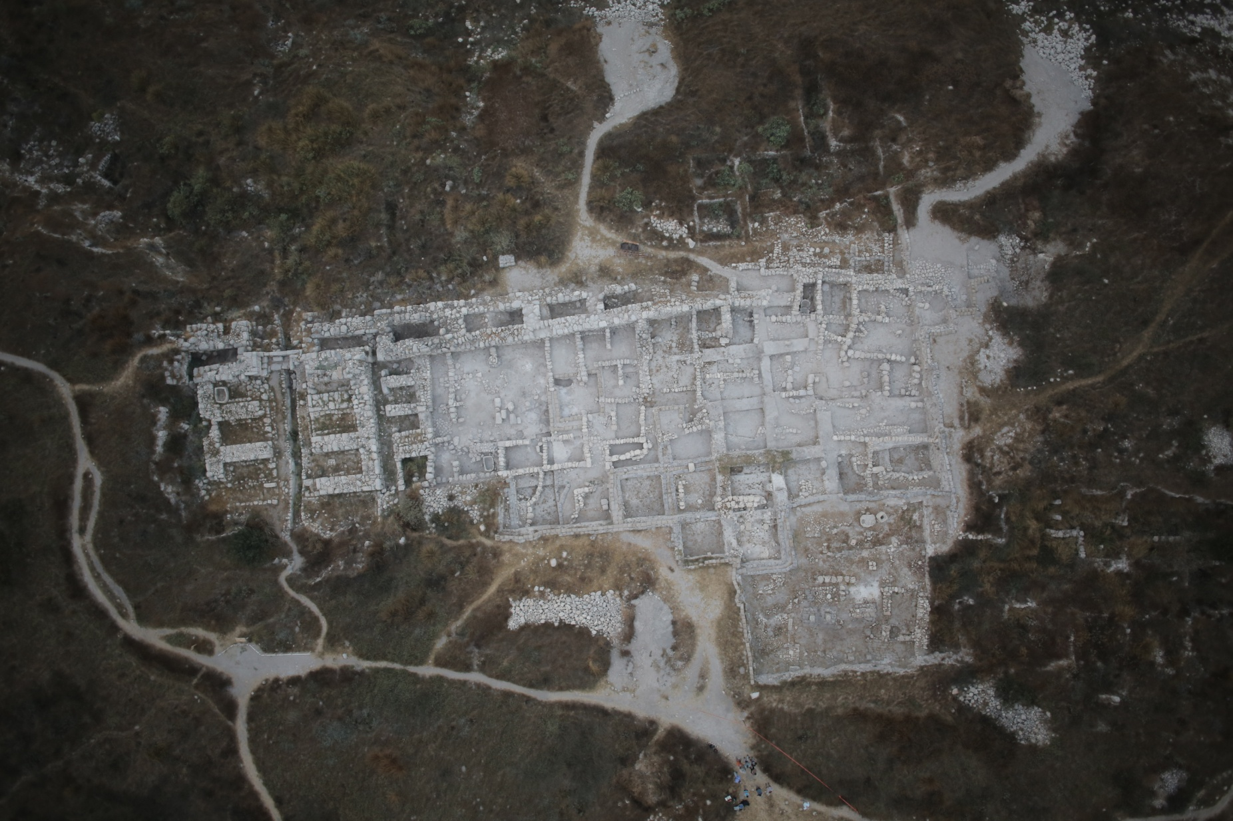
TEL GEZER, ISRAEL

Slide 3
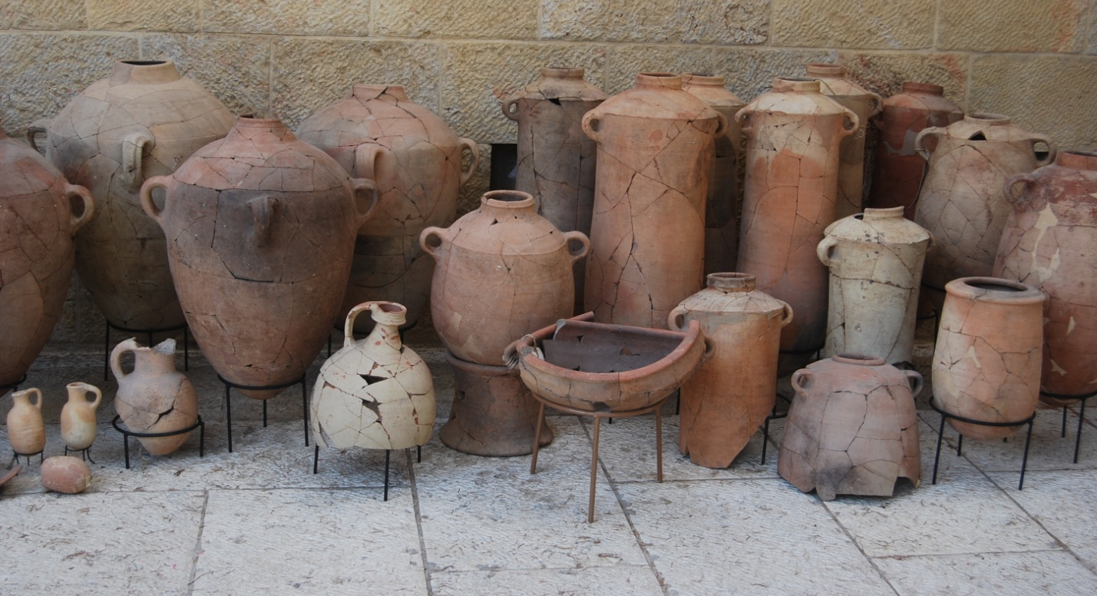
ARCHITECTURE, MATERIAL CULTURE, POTTERY

Slide 4
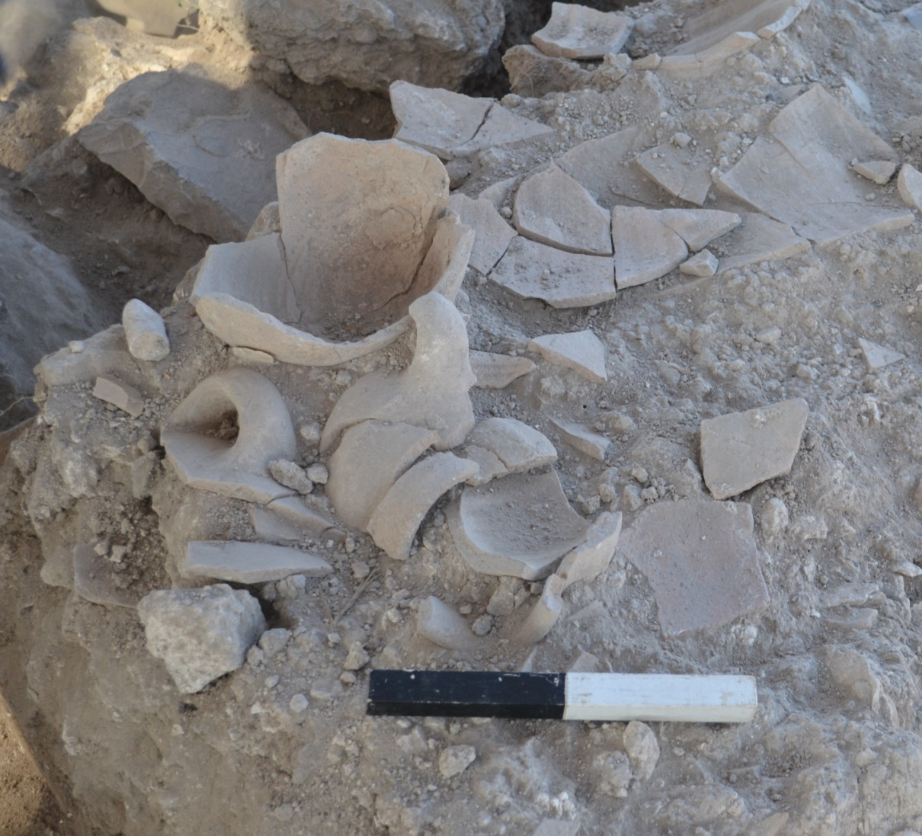
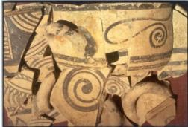
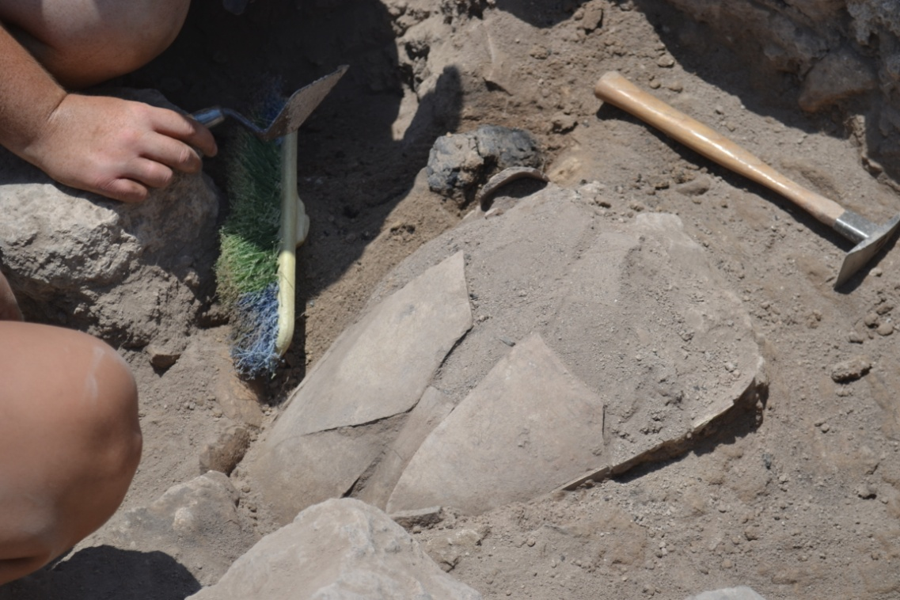
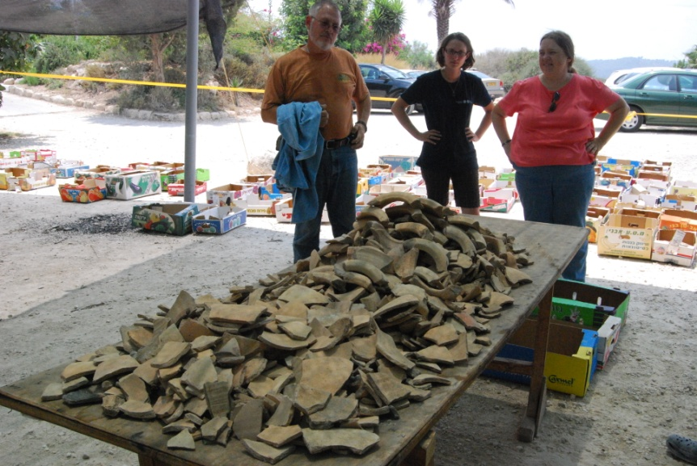
LOTS OF BROKEN POTTERY

Slide 5
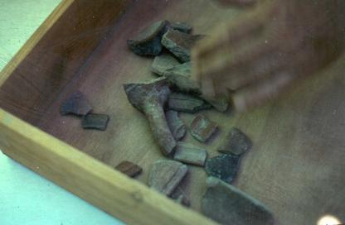
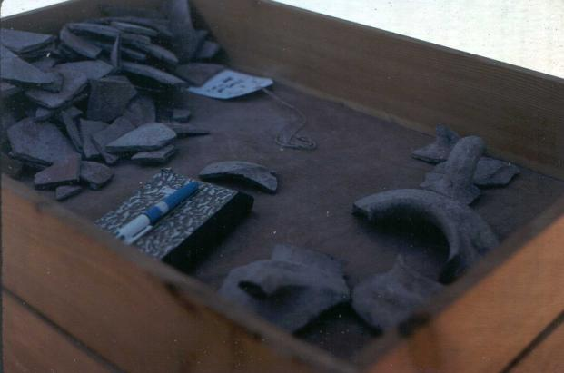
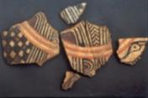
DIAGNOSTIC SHERDS
RIMS
BASES
HANDLES
DECORATIONS

Slide 6
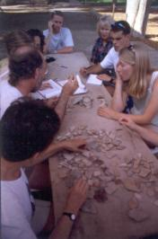
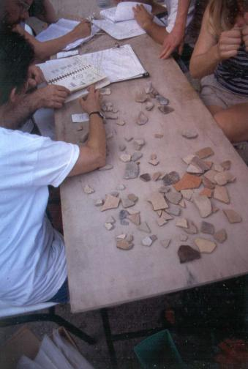
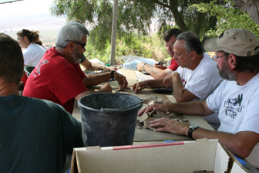
READING POTTERY
WHY????
*TYPE
*USE
*DATING

Slide 7
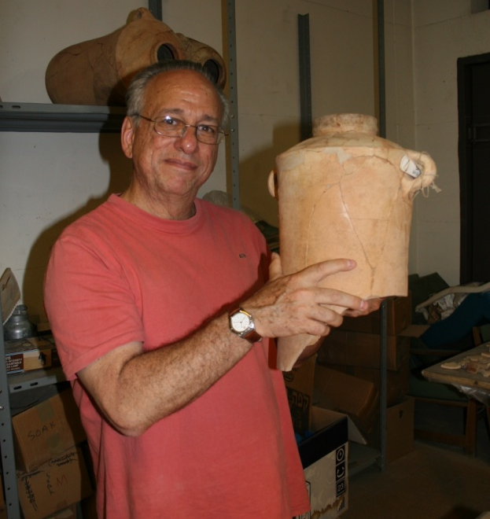
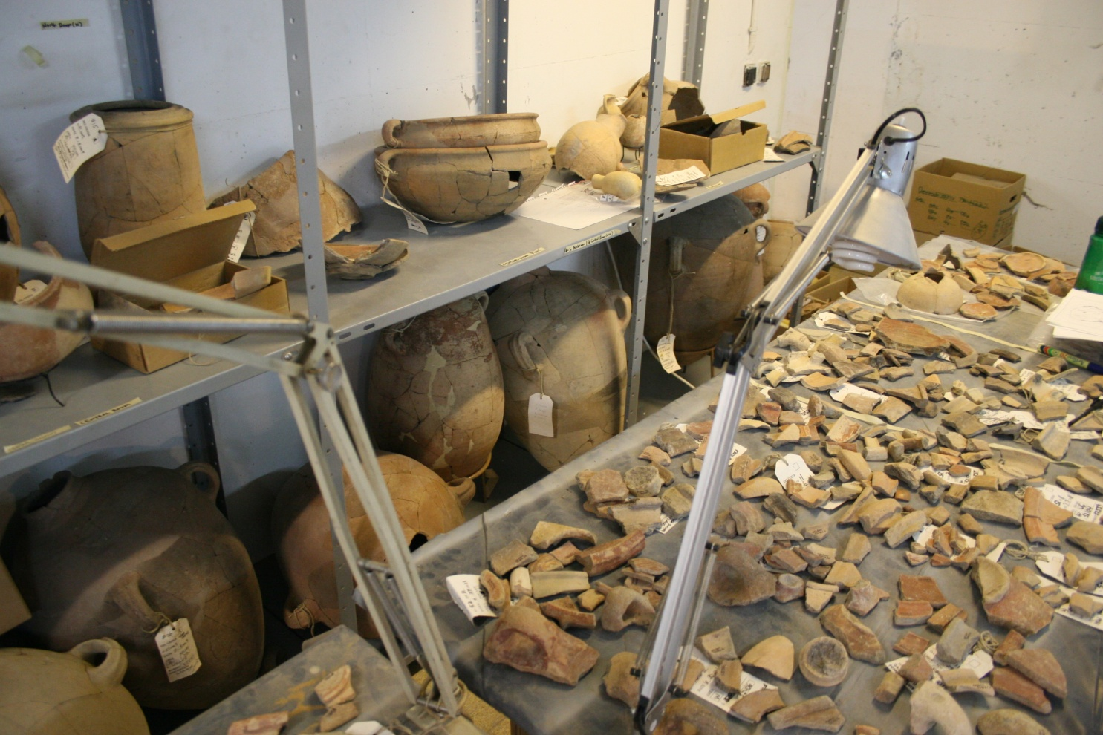
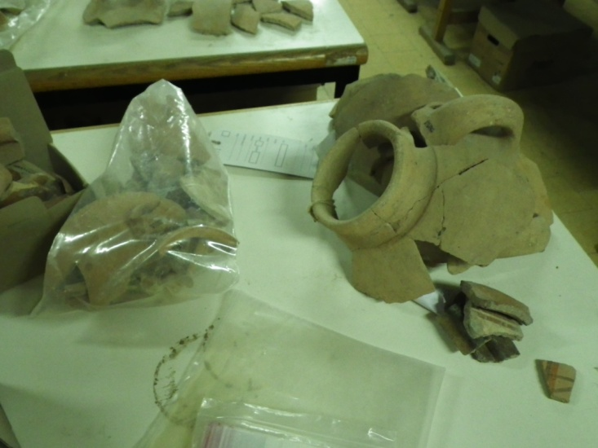
RESTORATION

Slide 8
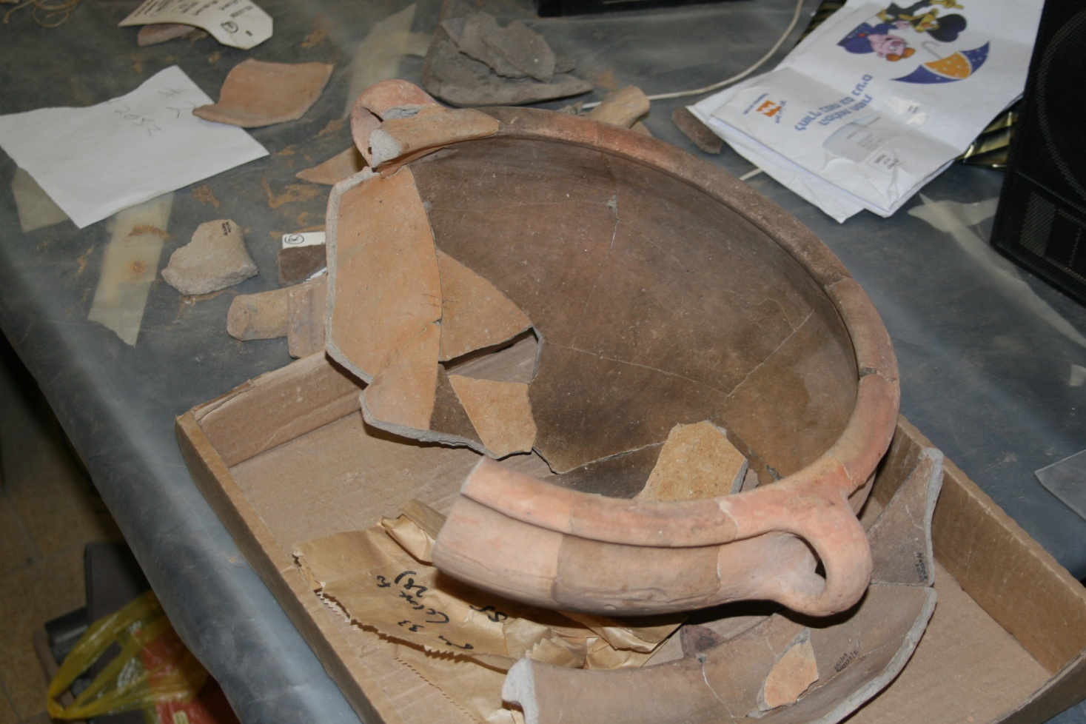
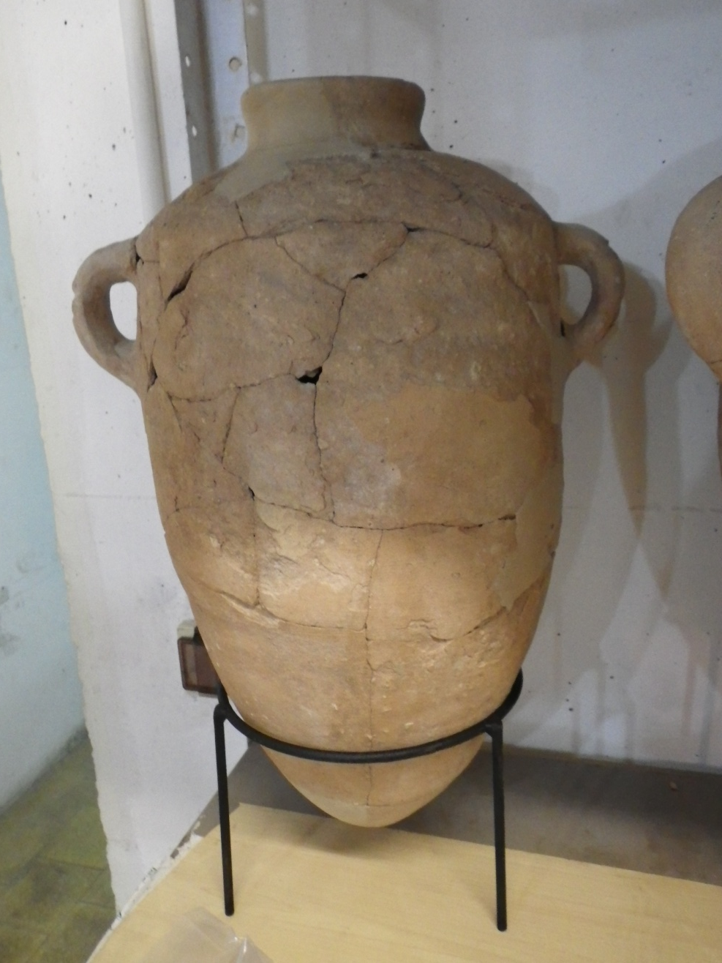
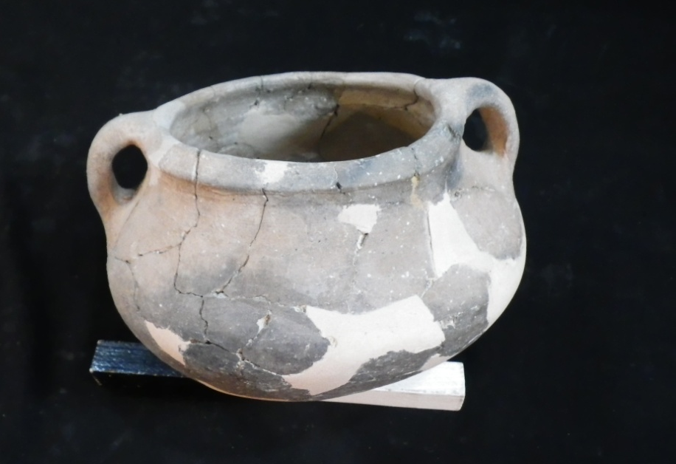

Slide 9
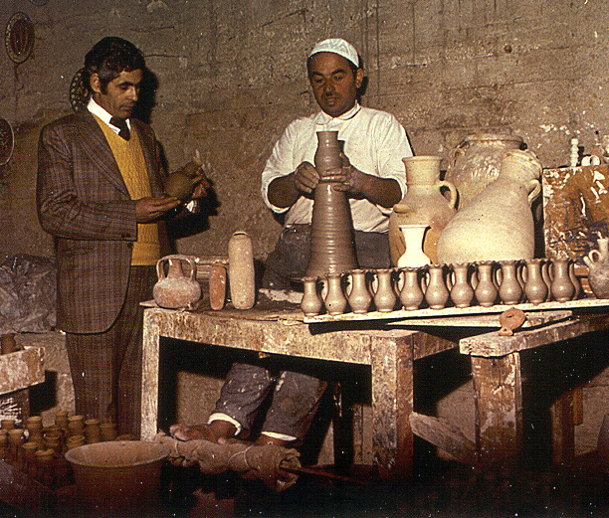
JEREMIAH 18-19: TWO IMAGES OF POTTERY
WHICH ARE YOU??? WHICH DO YOU WANNA BE?

Slide 10
RESTORED BUT STILL FRAGILE CONTAINERS 2 COR 4:7 – TREASURE OF GOD INSIDE

Slide 11
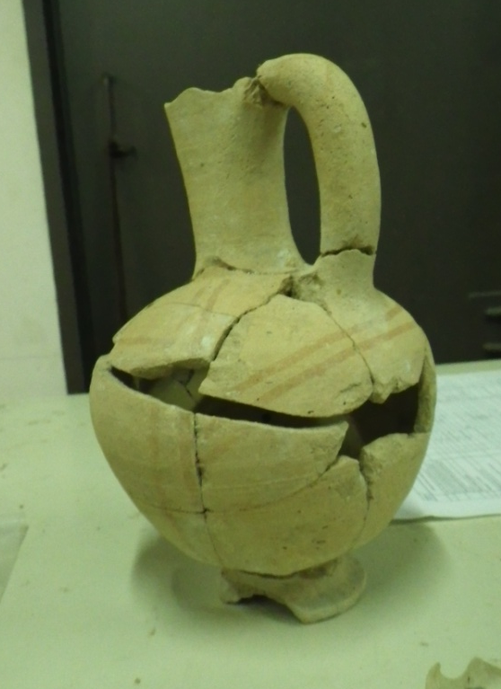
DIVERSITY AMONG FRAGILE POTTERY

Slide 12
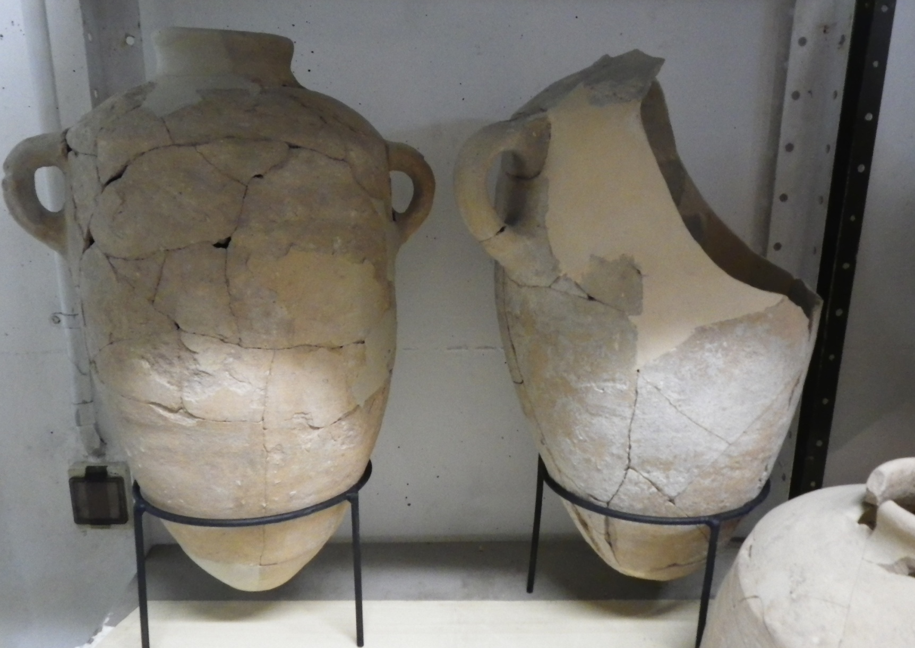
DIVERSITY AND NECESSITY IN A SINGLE POT – 1 COR 12:12f
RIMS, BASES, HANDLES, BODY SHERDS – ALL ARE NEEDED
FOR A FUNCTIONAL AND AESTHETIC VESSEL

