Slide 1
1 Peter 1:1-2, 2:9-10, 3:13-15

Slide 2
F
Father ->Spirit->Son
Peter, an apostle of Jesus Christ: To the temporary residents dispersed in Pontus, Galatia, Cappadocia, Asia, and Bithynia, chosen according to the foreknowledge of God the Father and set apart by the Spirit for obedience and for sprinkling with the blood of Jesus Christ.

Slide 3
F
Royal Priesthood
But you are the ones chosen by God, chosen for the high calling of priestly work, chosen to be a holy people, God’s instruments to do his work and speak out for him, to tell others of the night-and-day difference he made for you—from nothing to something, from rejected to accepted. 1 Peter 2:9-10 MSG

Slide 4
Prayer
Care
Share

Slide 5
Maz
And who will harm you if you are deeply committed to what is good? But even if you should suffer for righteousness, you are blessed. Do not fear what they fear or be disturbed, but honor the Messiah as Lord in your hearts. Always be ready to give a defense to anyone who asks you for a reason for the hope that is in you. However, do this with gentleness and respect, keeping your conscience clear, so that when you are accused, those who denounce your Christian life will be put to shame. 1 Peter 3:14-16

Slide 7
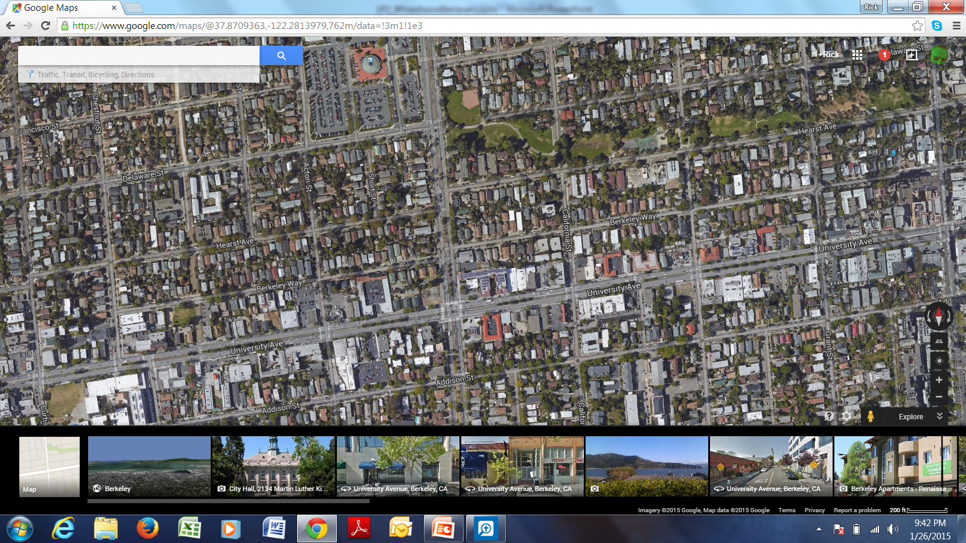

Slide 8
Prayer
Care
Share
God to bless their lives
Open hearts for His presence and the good news
For a simple, substantial way to show care for them.

Slide 9
Prayer
Care
Share
For a simple, substantial way to show care for them.
For a super-natural opportunity to share the way of Christ

Slide 10
Maz
https://www.youtube.com/watch?v=GHIDZObe_qY
https://www.youtube.com/watch?v=GHIDZObe_qY

Slide 11
F
Royal Priesthood
But you are the ones chosen by God, chosen for the high calling of priestly work, chosen to be a holy people, God’s instruments to do his work and speak out for him, to tell others of the night-and-day difference he made for you—from nothing to something, from rejected to accepted. 1 Peter 2:9-10 MSG

Slide 12
Maz
And who will harm you if you are deeply committed to what is good? But even if you should suffer for righteousness, you are blessed. Do not fear what they fear or be disturbed, but honor the Messiah as Lord in your hearts. Always be ready to give a defense to anyone who asks you for a reason for the hope that is in you. However, do this with gentleness and respect, keeping your conscience clear, so that when you are accused, those who denounce your Christian life will be put to shame. 1 Peter 3:15

Slide 14
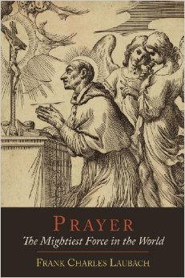

Slide 15
What, Father, do you desire said in this moment?
What, Father, do you desire done in this moment?

Slide 16
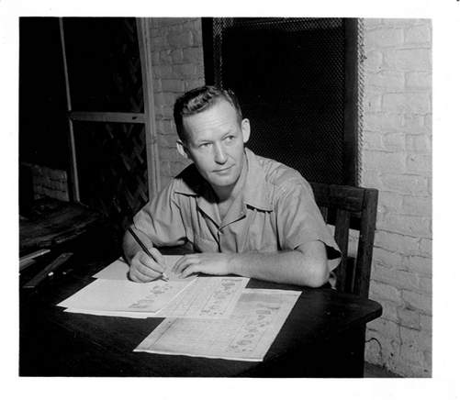

Slide 17
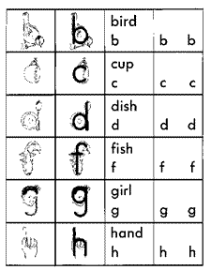

Slide 18
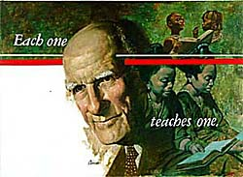

Slide 19
Good will
Good Words
Good deeds

Slide 20
1 Peter 1:1-2, 2:9-10, 3:13-15

