Slide 1
Islam Vs. Christianity
Pastor John Fong
February 15, 2015
Berkeley Crossroads Baptist

Slide 2
How do you test religions?
Just ask three questions!

Slide 3
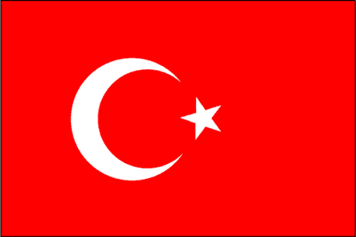
Three Questions
1) WHAT IS YOUR AUTHORITY?
2) WHO IS JESUS CHRIST?
3) HOW IS A PERSON SAVED?

Slide 4
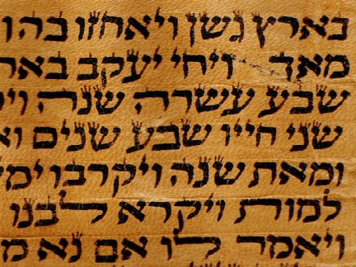
WHAT IS YOUR AUTHORITY?
Four God-inspired Books:
THE PENTATEUCH OF MOSES

Slide 5
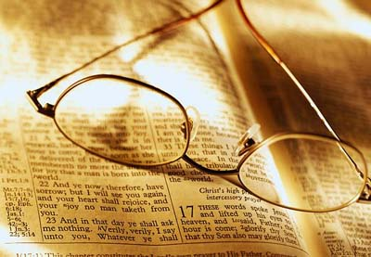
THE PSALMS OF DAVID

Slide 6
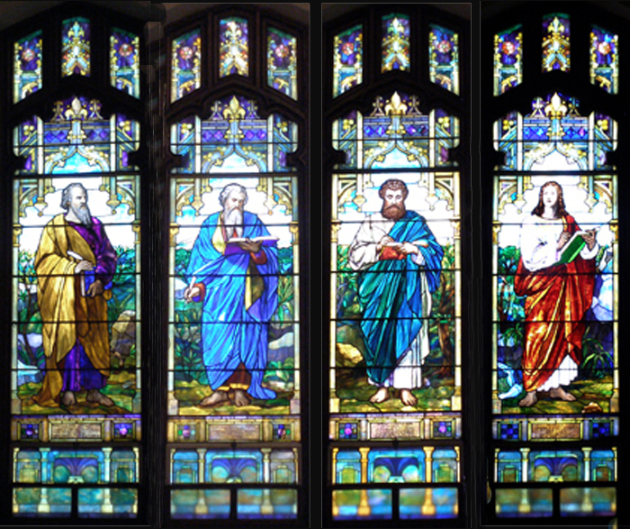
THE GOSPEL OF JESUS, AND

Slide 7
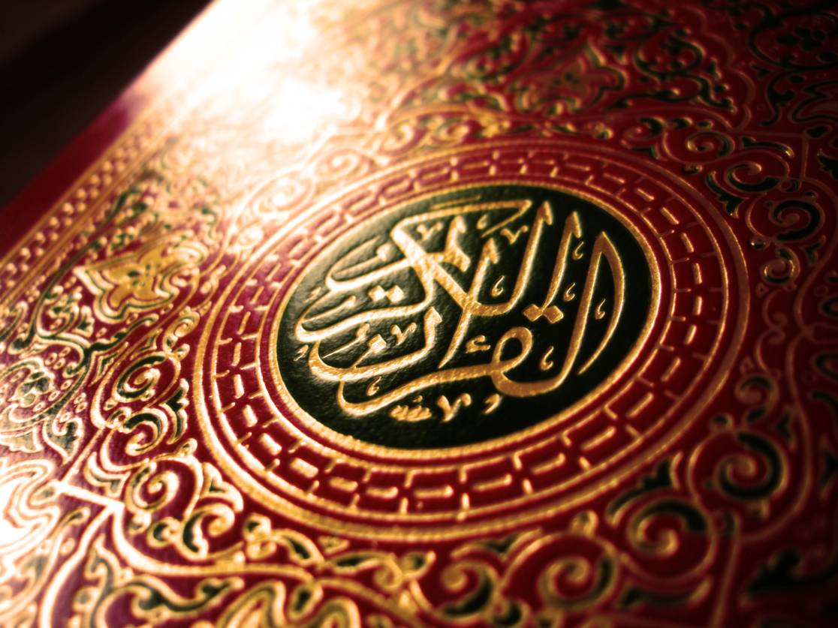
THE HOLY QURAN.

Slide 8
Muslims believe the first three
are corrupted.
Therefore, the Quran supersedes them.

Slide 9
The Quran is the Final Testament!
Mohammad refers to the Bible as truth, but his doctrines often contradict Biblical teaching.
Examples…

Slide 10
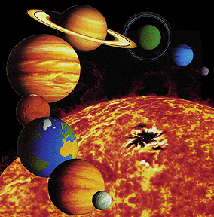
God Created Seven Earths
God created seven universes and the same number of earths.
--Surah 65:12

Slide 11
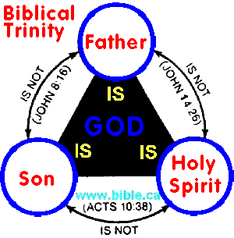
Quran Denies the Trinity
Pagans indeed are those who say that God is a third of a trinity. There is no god except the one [G]od. --Surah 5:73A

Slide 12
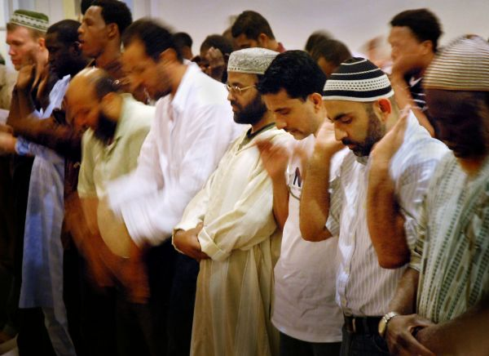
Worship is on Friday
When the Congregational Prayer is announced on Friday, you shall…drop all business.
--Surah 62:9

Slide 13
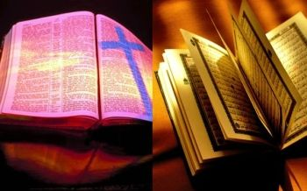
Bible Vs. Quran
When there is a conflict between the Quran and the Bible, Muslims say that the Bible is corrupted and not accurate.

Slide 14
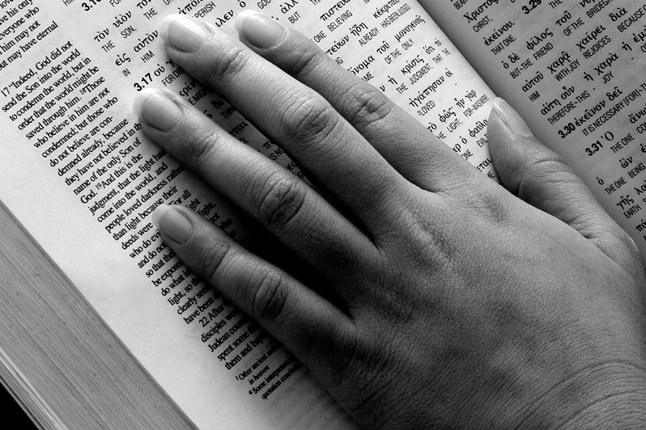
Muslims ridicule Bible’s many translations. E.g. KJV, NIV, NLT

Slide 15
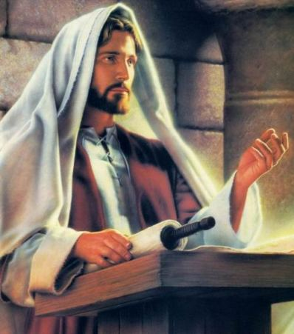
WHO IS JESUS?
Generally, Jesus is one of many 28 great prophets.

Slide 16
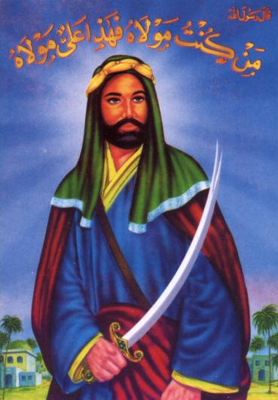
Jesus is the sinless prophet, but Mohammed is the last and greatest prophet.

Slide 17
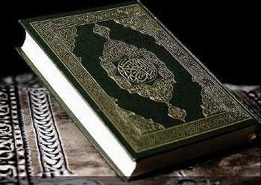
Specifically, the Quran teaches that Jesus…

Slide 18
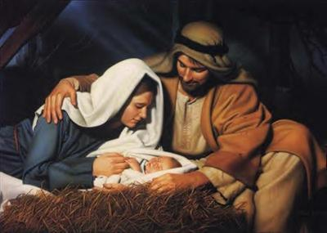
MIRACULOUSLY BORN TO VIRGIN MARY, 66:12
Also, Mary, the Amramite. She maintained her chastity, then we blew into her from our spirit.

Slide 19
JESUS BORN UNDER PALM TREE, 19:23
When she [Mary] bore him [Jesus], she isolated herself to a faraway place. The birth process came to her by the trunk of a palm tree…[the infant Jesus] called her from beneath her, saying,

Slide 20
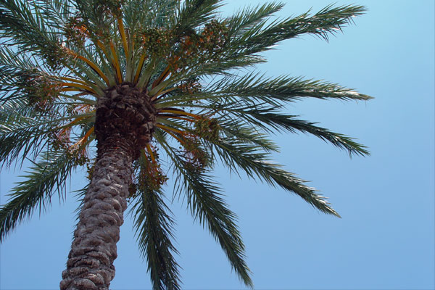
‘Do not grieve. Your Lord has provided you with a stream. If you shake the trunk of this palm tree, it will drop ripe dates for you.’

Slide 21
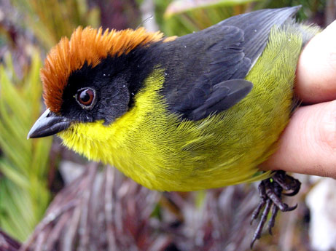
BREATHED LIFE INTO CLAY, 3:49
I come to you with a sign from your Lord—I create for you from clay the shape of a
bird, then blow into
it, and it becomes
a live bird by God’s
leave.

Slide 22
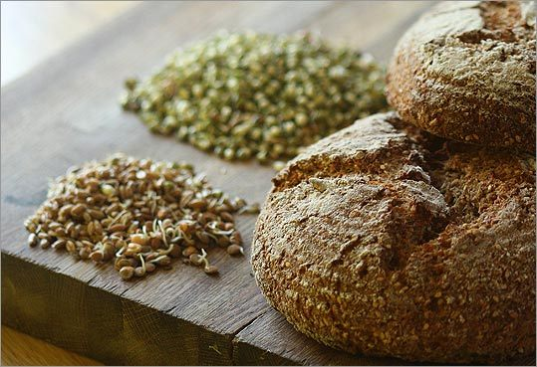
KNOWS ALL THINGS, 3:49C
I (Jesus) can tell you what you eat, and what you store in your homes. This should be a
proof for you,
if you are
believers.

Slide 23
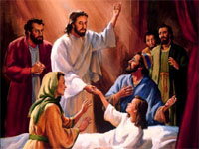
PERFORMED MIRACLES, 3:49B
I (Jesus) restore vision to the blind, heal the leprous, and I revive the dead by God’s leave.

Slide 24
DID NOT DIE ON THE CROSS, 4:157
And for claiming that they killed the Messiah, Jesus, son of Mary, the messenger of God.
In fact, they never killed him, they never crucified him—they were made to think that they did.

Slide 25
JESUS WAS NOT SON OF GOD, 9:30B
Christians said, ‘Jesus is the son of God!’ These are blasphemies uttered by their
mouths.

Slide 26
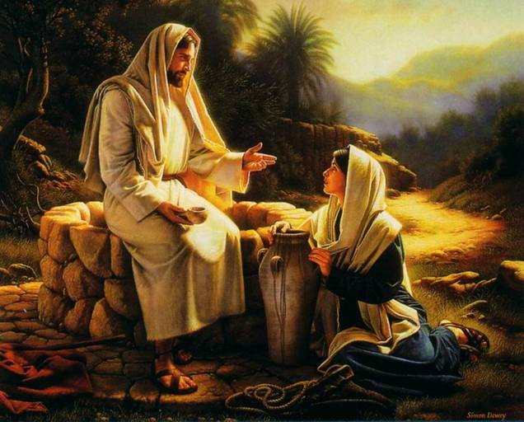
JESUS VS. MOHAMMED
JESUS MOHAMMED
WROTE NO BOOKS WROTE QURAN
NEVER MARRIED MARRIED 15 WIVES
LIVED SINLESS LIFE ASK/FORGIVENESS
WAGED NO WAR WAGED 66 BATTLES

Slide 27
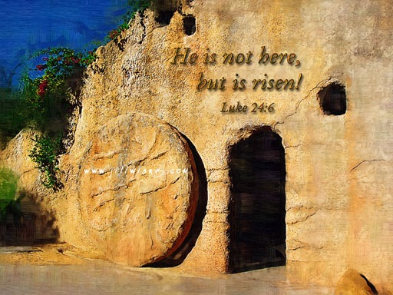
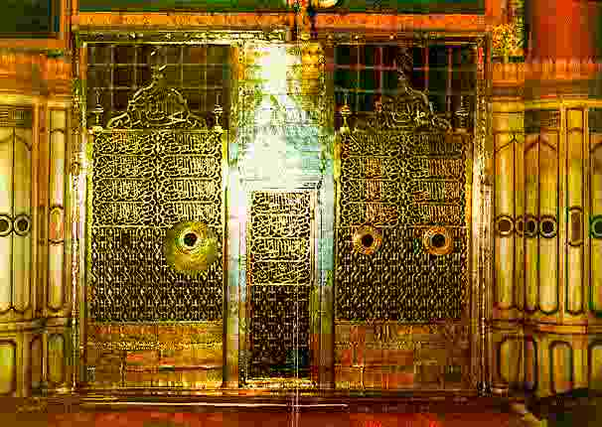
JESUS MOHAMMED
ORDER NO DEATH MANY DEATHS
RELIGION OF LOVE RELIGION OF SWORD
DIED MID-30’S DIED WHEN 62
RAISED FROM DEAD STILL LINGERS IN HIS GRAVE

Slide 28
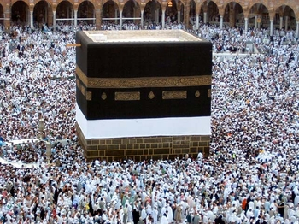
HOW IS A PERSON SAVED?
The Quran proclaims that a man must earn his own salvation.

Slide 29
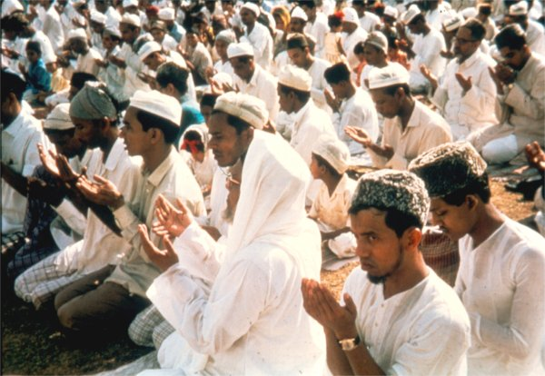
Muslims believe the Five Articles of Faith and follow the Five Pillars of Faith.

Slide 30
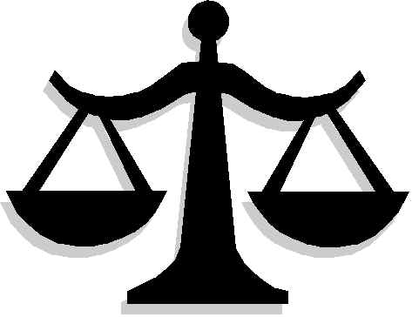
SALVATION BY GOOD WORKS
The scales will be set on that day, equitably. Those whose weights are heavy will be the winners.

Slide 31
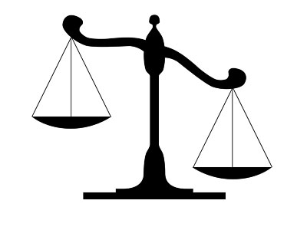
As for those whose weights are
light, they will be the ones who lost their souls as a conse- quence of disregarding our revelations,
unjustly.
--Surah 7:8-9

Slide 32
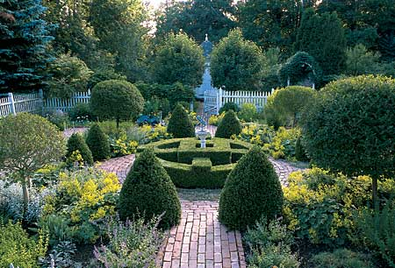
Rewards for Righteous Behavior
For those who believe and work righteous deeds, there is forgiveness and a magnificent Reward.
--Surah 35:7B

Slide 33
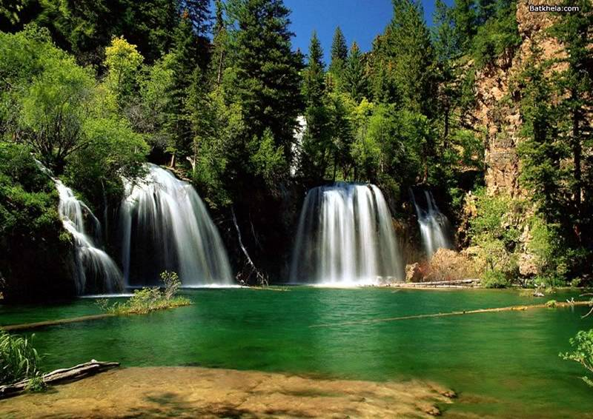
Paradise (Janna)
Enjoy orchards and grapes
Drink from rivers of milk and honey
Relax on luxurious furnishings
Matched with beautiful spouses

Slide 34
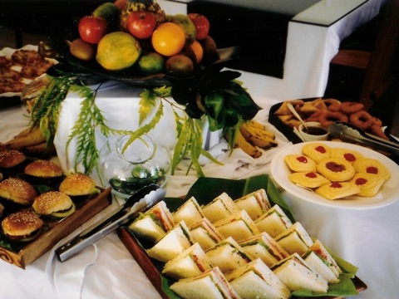
Find everything their hearts desire and the eyes wish for
Served by immortal servants

Slide 35
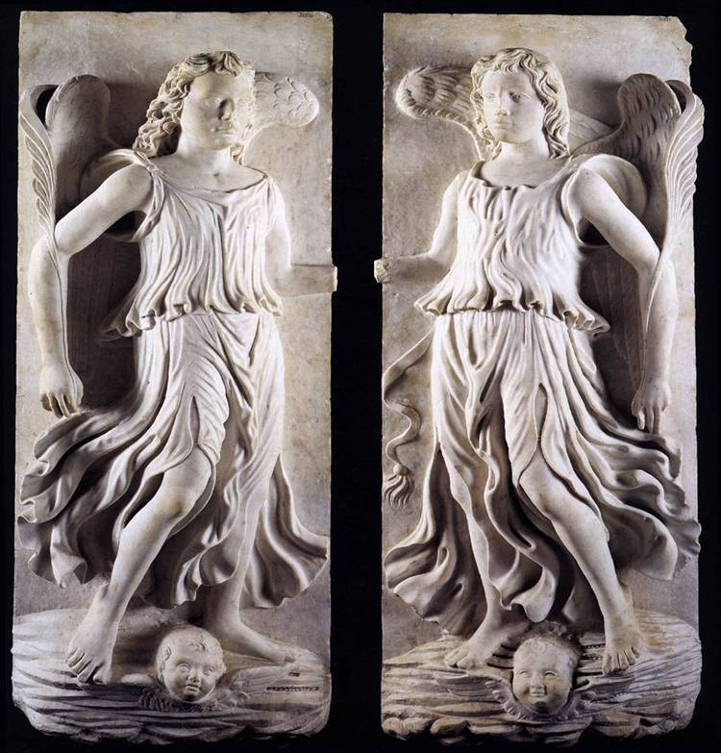
Judgment Day
Muslims fear Judgment Day, in
which “recording angels”
keep a list of every
deed, both good
and bad.

Slide 36
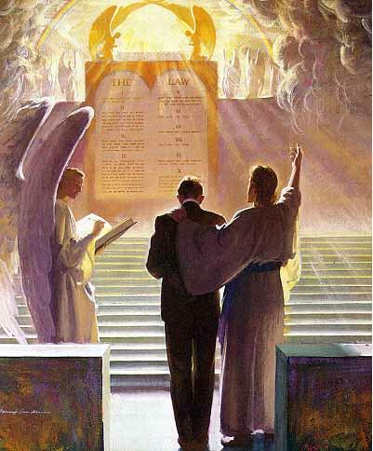
What You Can Share with Muslims
All will be judged, but believers will be saved because
God removed the
record that contain-
ed the charges
against them.

Slide 37
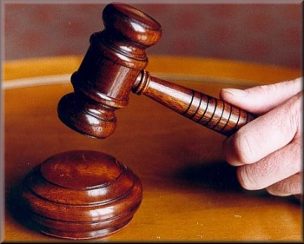
The Gift of Salvation
Even if one’s list of good deeds outweighed their list of bad deeds, it would not make them acceptable to God.

Slide 38
Reaching Muslims
Do approach Muslims as a learner
Seek commonality to get started
Do talk about Jesus, but don’t insult prophet Mohammed

Slide 39
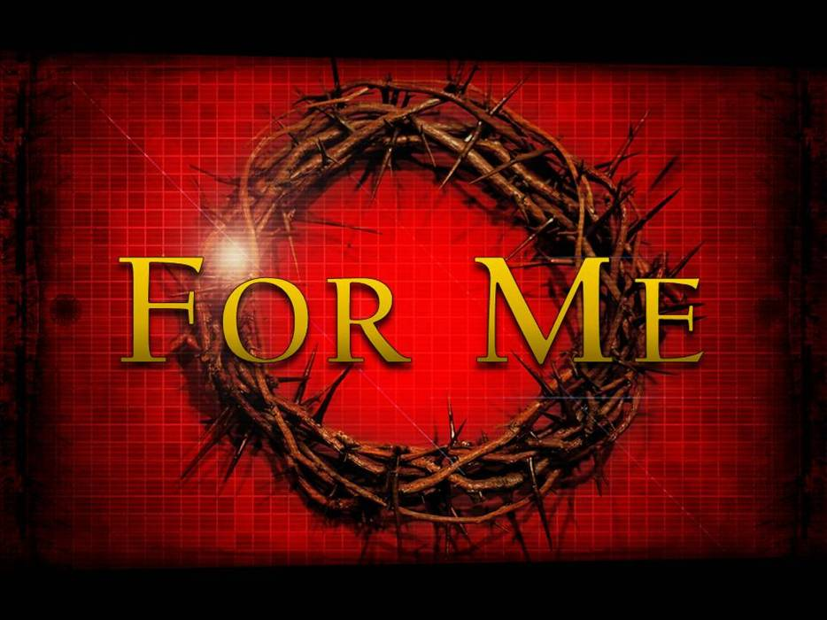
Do emphasize that Jesus was submissive in going to the cross for the sins of mankind.

Slide 40
Do honor Muslim values

Slide 41
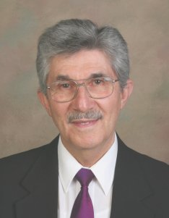
Resource
Dr. Nabeel Jabbour
Arab Christian, scholar, author
Expert on Muslim culture
http://www.nabeeljabbour.com

