Slide 1
In Christ’s Image: Male and Female
In the Church– 1 Cor. 11 & 14

Slide 2
In Christ’s Image: In the Church
When you come together, each one has a hymn, a lesson, a revelation, a tongue, or an interpretation. Let all things be done for edification. 14:26
Order ardor!

Slide 3
In Christ’s Image: In the Church

Slide 4
In Christ’s Image: In the Church

Slide 5
In Christ’s Image: In the Church
Ardor over order makes worship confusing.
Order over ardor makes worship unconvincing.
Ordered ardor makes worship believable.

Slide 6
In Christ’s Image: In the Church
When we get ardor ordered:
“But if all prophesy, and an unbeliever or outsider enters, he is convicted by all , he is called to account by all, the secrets of his heart are disclosed; and so falling on his face, he will worship God and declare that God is really among you.” 14:24-25

Slide 7
In Christ’s Image: In the Church
Never be so fearful of wildfire that you snuff out all fire.
1 Thess. 5:19

Slide 8
In Christ’s Image: In the Church

Slide 9
In Christ’s Image: In the Church

Slide 10
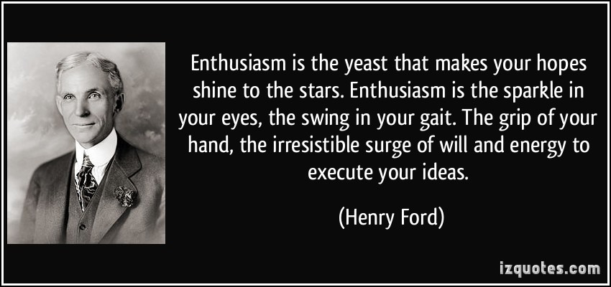
In Christ’s Image: In the Church

Slide 11
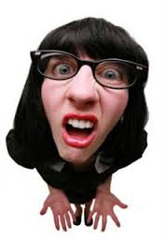
In Christ’s Image: In the Church

Slide 12
In Christ’s Image: In the Church
“But I want you to understand that the head of every man is Christ, the head of a woman is her husband, and the head of Christ is God. Any man who prays or prophecies with his head covered dishonors his head, but any woman who prays or prophecies with her head unveiled dishonors her head….” 1 Cor. 11:3-5

Slide 13
In Christ’s Image: In the Church
Intelligence is the ability to discern relationships.

Slide 14
In Christ’s Image: In the Church
Let ardor be done in order.
1 Cor. 14:40

Slide 15
In Christ’s Image: In the Church
God
Christ
Husband
Wife
Exercising spiritual gifts while honoring relationships

Slide 16
In Christ’s Image: In the Church
Spiritual abilities must integrate with functional responsibility.
Gifting does not override relating or we would need to leave our wedding rings at the door.
Relating must not suppress gifting or we are telling the Holy Spirit not to come to our church.

Slide 17
In Christ’s Image: In the Church
Spiritual gifts are poured out on believers without regard to gender.
This affirms the equality of essence in the image of Christ.

Slide 18
In Christ’s Image: In the Church
Spirit’s Motive
Lord’s Ministry
God’s Manifestation
I Cor. 12:4-6 Gifting

Slide 19
In Christ’s Image: In the Church
Enthusiasm requires propriety to be sustainable.
Notes:
The problem at Corinth was that women were exercising spiritual gifts as if marital relationships no longer mattered.
The problem at Corinth was not what was coming out of the mouths of the wives but what was not on top of their heads.
Hair length and head coverings are cultural manifestations of gender identifications. Despite the manifestation of gifts without regard to gender, exercise of those gifts must be done with propriety in regard to gender last marriage and unity be damaged.

Slide 20
In Christ’s Image: In the Church
The unity of the marriage and unity of the church must never be pitted against each other.

Slide 21
In Christ’s Image: In the Church
Essential
Innocence
Existential
In Sin
Ecclesial
In Christ
Eschato-
logical
Humanity in Four Movements

Slide 22
In Christ’s Image: In the Church
As in all the churches of the saints, women should keep silence in the churches. For they are not permitted to speak, but should be subordinate, even as the law says. If there is anything they desire to know, let them ask their husbands at home. For it is shameful for a woman to speak in church. 1 Cor. 14:33-36
Notes:
What you can do with your mouth in worship:
Pray, Prophesy, tongues, interpretation, speak, silence.

Slide 23
In Christ’s Image: In the Church
Four interpretations of 1 Cor. 14:34
Delete it since it is okay to pray and prophecy.
Don’t condone disruptive conversations in worship.
Obey it but it is okay to pray and prophesy.
Orchestrate loyalties to home and church. Get win-wins.

Slide 24
In Christ’s Image: In the Church
“But if all prophesy…” Why is prophesy so important?
The Spirit of Christ is the spirit of prophecy.

Slide 25
In Christ’s Image
In the Church – 1 Peter 3:1-7

