Slide 1
The Amazing Influence of the Bible
Pastor John Fong
September 21, 2014
Berkeley Crossroads Baptist Church

Slide 2
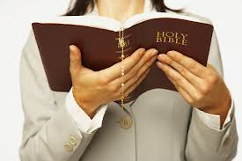
Book of All Books
It’s the number one best seller!
It has influenced people from all walks of life!

Slide 3
Examples of Biblical Influence:
Science
Arts
Literature
Every Day Life
Reference: What If the Bible Had Never Been Written? D. James Kennedy

Slide 4
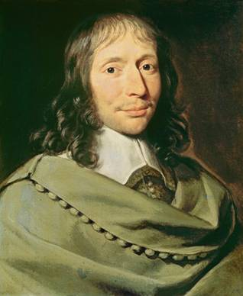
SCIENCE
Blaise Pascal (Mathematician)
“Jesus Christ is the only proof of the living God. We only know God through
Jesus Christ.”

Slide 5
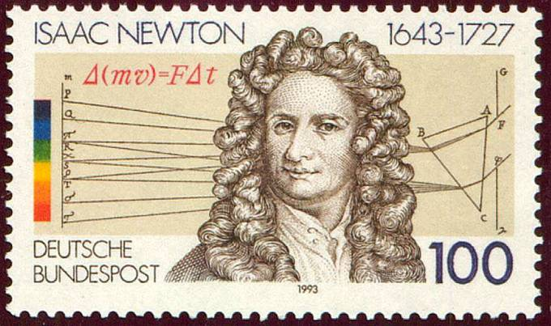
Sir Isaac Newton (Math and Physics)
“I have a foundational belief in the Bible as the Word of God, written by men who were inspired. I study the Bible daily.”

Slide 6
FOUNDERS OF BRANCHES OF SCIENCE
LOUIS PASTEUR
Father of Immunology/Microbiology

Slide 7
JOSEPH LISTER
Father of Antiseptic Survey

Slide 8
GREGOR MENDEL
Father of Genetics

Slide 9
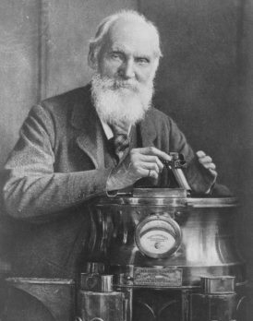
LORD KELVIN
Father of Laws of Thermodynamics

Slide 10
SIR ISAAC NEWTON
Father of Universal Law of Gravitation

Slide 11
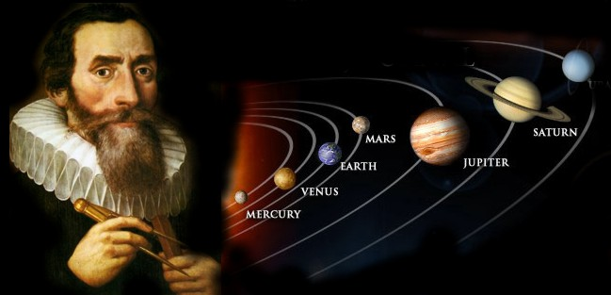
JOHANNES KEPLER
Father of Physical Astronomy

Slide 12
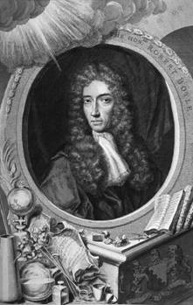
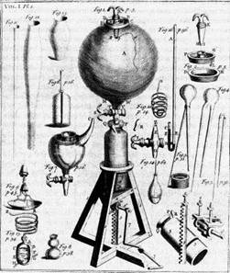
ROBERT BOYLE
Father of Modern Chemistry

Slide 13
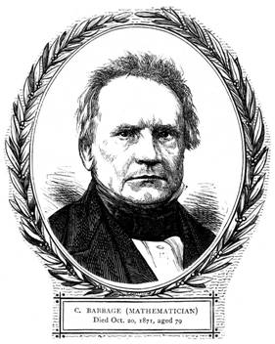
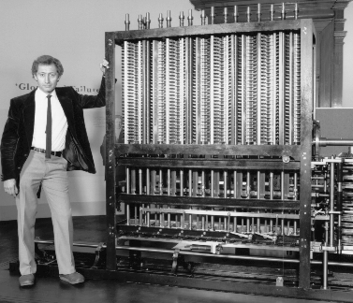
CHARLES BABBAGE
Father of Computer Science

Slide 14
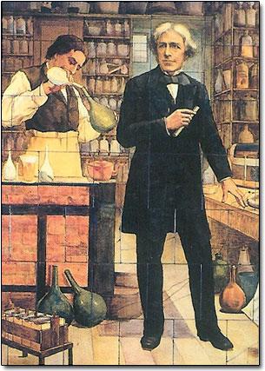
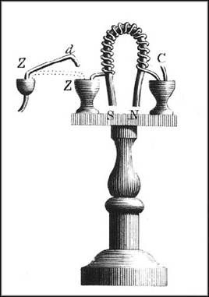
MICHAEL FARADAY
Father of Electromagnetics

Slide 15
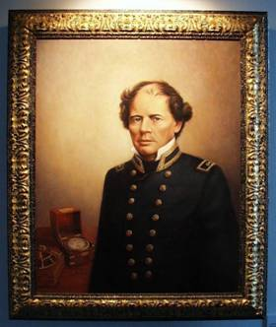
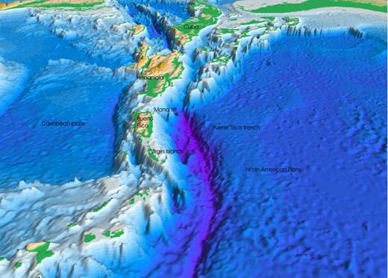
MATTHEW MAURY
Father of Oceanography

Slide 16
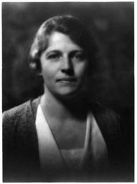
ARTS
Cynthia Pearl Maus
“More poems have been
written, more stories told,
more pictures painted,
and more songs sung
about Christ than any other
person in human story…”

Slide 17
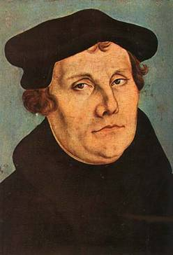
Music
Martin Luther

Slide 18
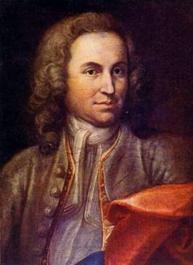
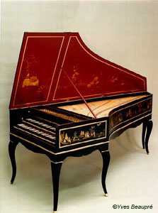
Johann Sebastian Bach

Slide 19
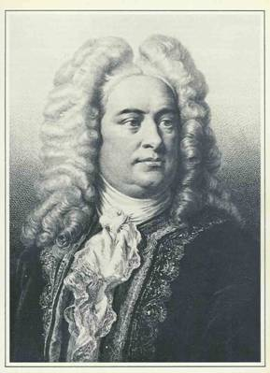
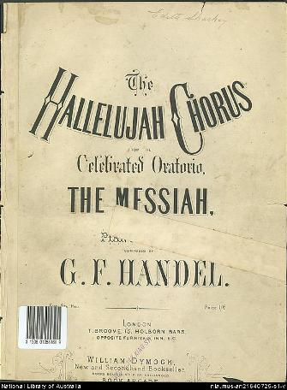
George Friedric Handel

Slide 20
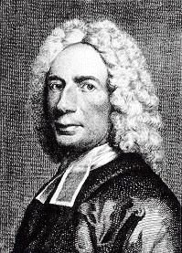
Isaac Watts

Slide 21
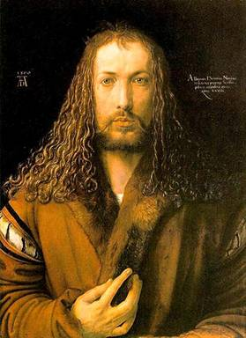
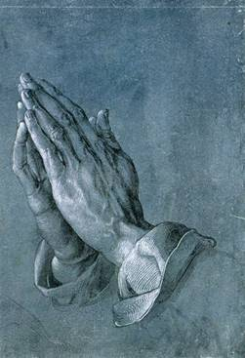
Fine Arts
Albrecht Durer

Slide 22
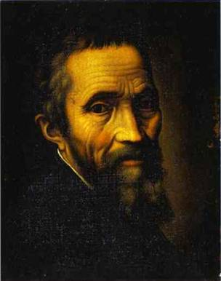
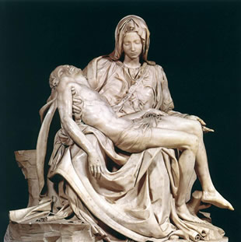
Michelangelo

Slide 23
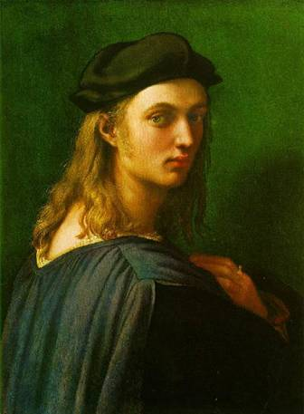
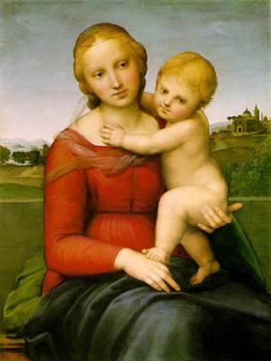
Raphael

Slide 24
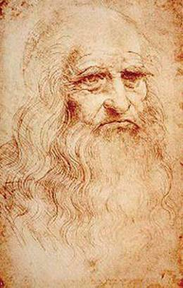
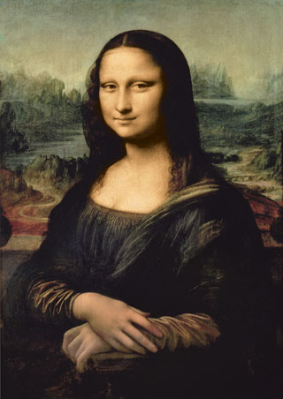
Leonardo da Vinci

Slide 25
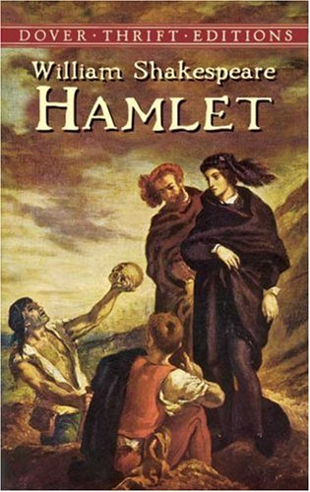
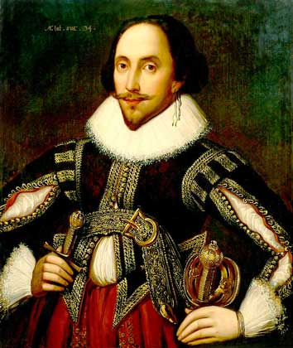
Literature
William Shakespeare

Slide 26
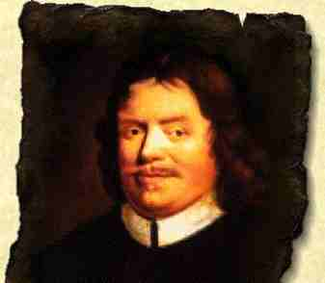
John Bunyan

Slide 27
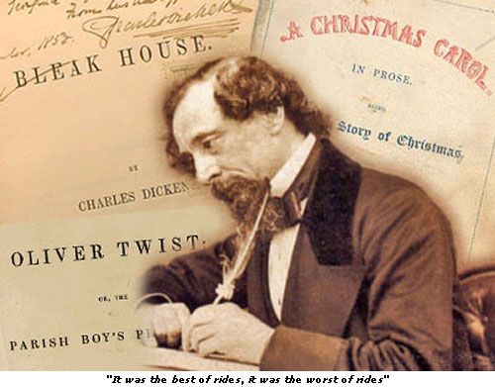
Charles Dickens

Slide 28
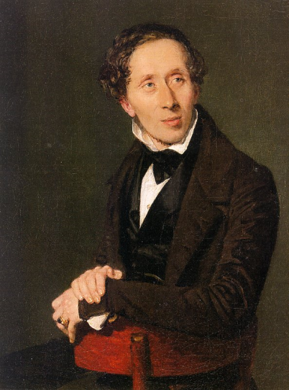
Hans Christian Andersen
The Tinder Box
The Princess and the Pea
Thumbelina
The Little Mermaid
The Emperor's New Clothes
His stories discuss God, angels, faith, the Bible, the afterlife, and sin.

Slide 29
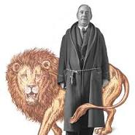
Clive Staples Lewis

Slide 30
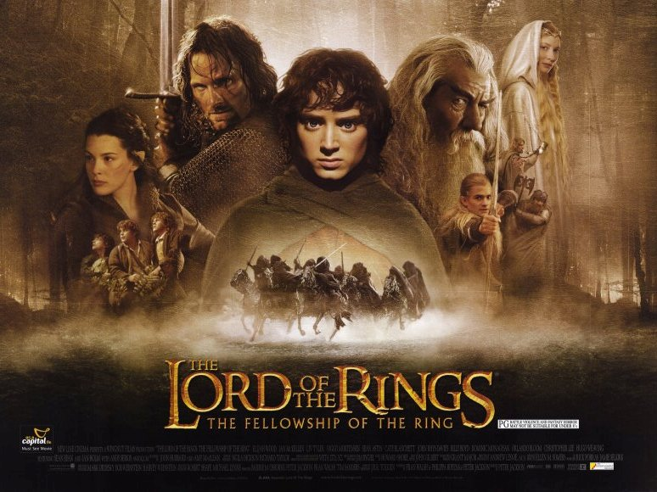
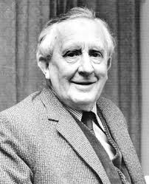
John Ronald Reuel Tolkien
Fellowship of the Rings

Slide 31
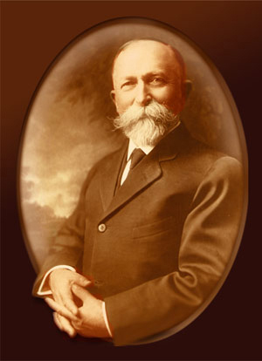
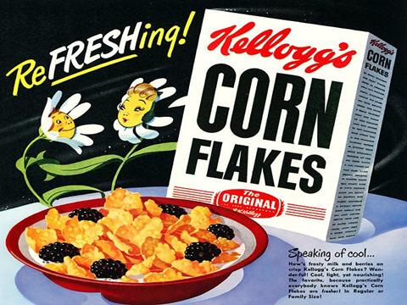
Every Day Life - Food
Dr. Harvey Kellogg

Slide 32
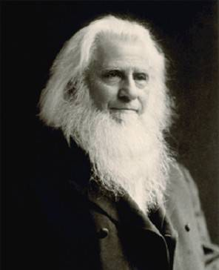
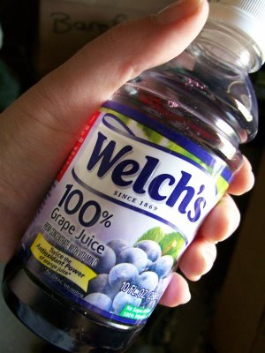
Thomas Welch, M.D.

Slide 33
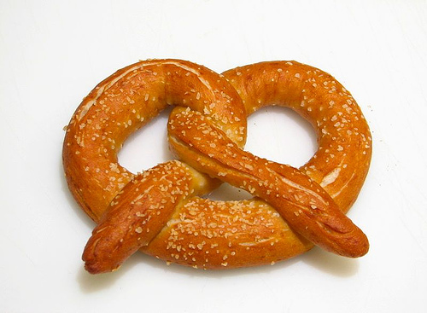
Pretzels

Slide 34
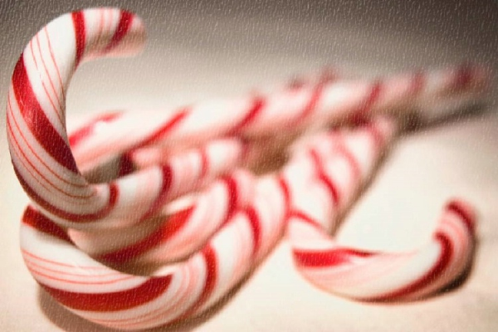
Candy Canes

Slide 35
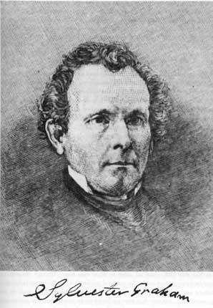
Rev. Sylvester Graham

Slide 36
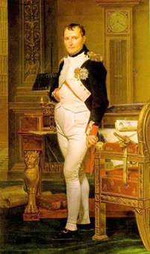
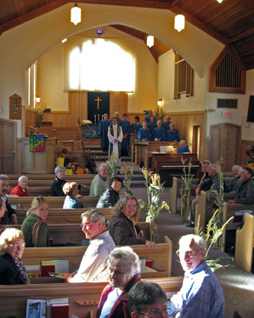
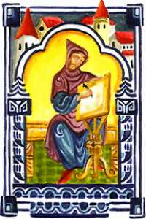
Calendar
Seven Day Weeks
Saturday to Sunday Worship
Modern Calendar – Dionysius Exiguus

Slide 37
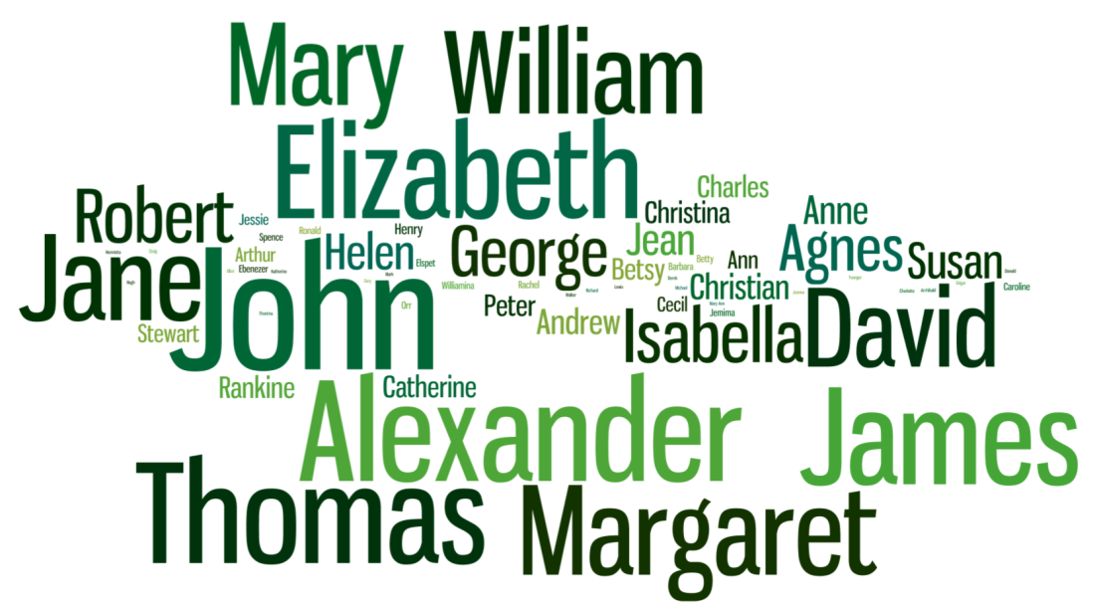
Language and Sayings
Etymology of…
“Bye”
“Holiday”
Christian names

Slide 38
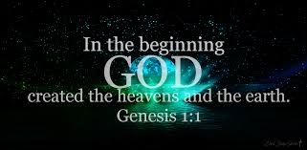
Common Sayings
“in the beginning”
“my brother’s keeper”
“an eye for an eye”
“the promised land”
“they shall beat their swords into plowshares”
“in the lion’s den”

Slide 39
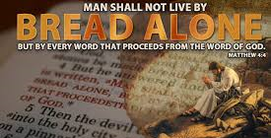
“man does not live by bread alone”
“turn the other cheek”
“go the second mile”
“don’t cast your pearls before swine”
“wolves in sheep’s clothing”
“a house divided against itself cannot stand”

Slide 40
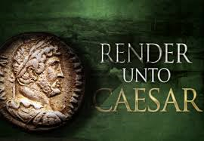
“render unto Caesar things which are Caesar’s”
“love your neighbor as yourself”
“the spirit is willing but the flesh is weak”
“prodigal son”
“the love of money is the root of all evil”
“valley of the shadow of death”

Slide 41
CONCLUSION
The Bible has influenced the world more than we know!
Let us share it with others!

