Slide 1
A Tour of the Kingdom
Rev. Yot Lee
Matthew 13:24-30

Slide 2
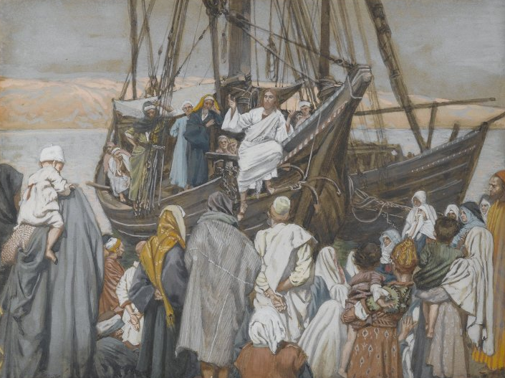
The Parable of the Sower
One day, Jesus was by the seaside. Many people came to hear Him teach. He sat in a ship and taught the crowd of people who stood on the shore and listened.

Slide 3
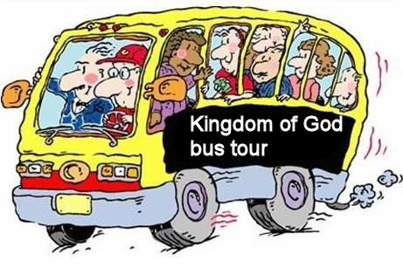

Slide 4
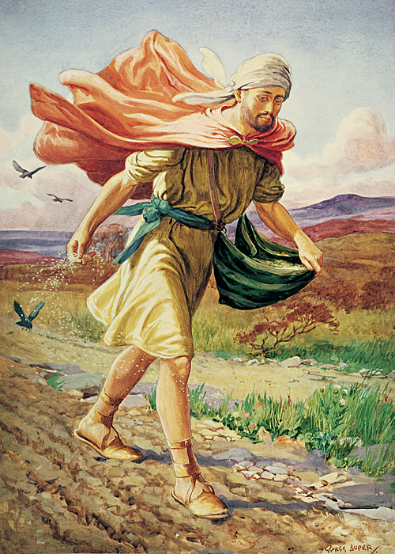
He spoke to them of a sower who planted seeds in different kinds of earth—stony, thorny, and fertile—and received different amounts of fruit.
Some of the seed fell to the wayside and was eaten up by birds.

Slide 5
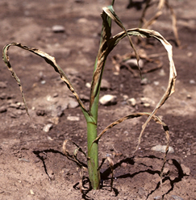
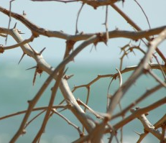
The seed that fell on the stony ground did not send roots deep into the ground.
The plants scorched in the sun.
Because the roots were not deep the plants withered and died.
Some of the seed fell where thorny plants grew.
When the they sprouted, the thorns choked them.

Slide 6
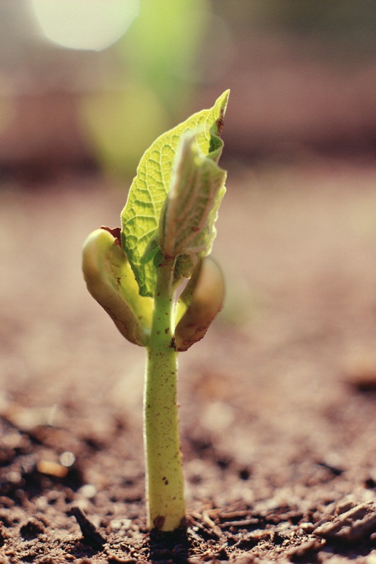
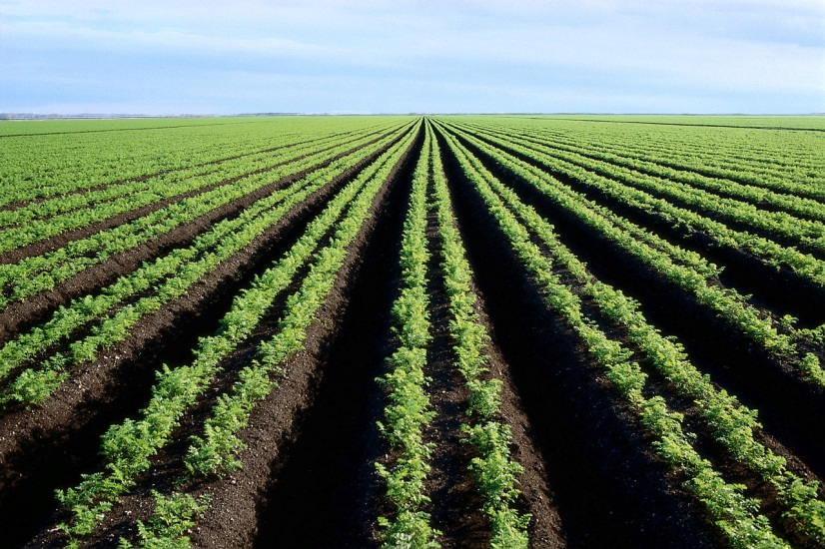
Other seed fell in good, fertile ground.
The seeds were able to send roots deep into the ground.
When the plants grew, they produced a lot of fruit.

Slide 7
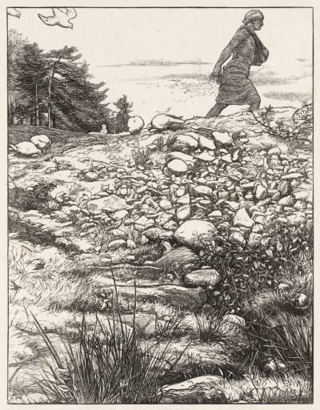
Let’s read Matthew 13:18–23, Mark 4:14–20, and Luke 8:11–15
What do you think the seed is?
What do the fowls (birds) that eat the seed represent?
What is the rocky ground?
What are the thorns?

Slide 8
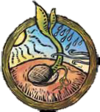
What is the good ground?
What are the roots?
What are the cares of the world?

Slide 9
The disciples did not understand the parable. Jesus explained that the seed is the Gospel or Word of God.
Each type of soil represents our commitment and ability to endure.
The wayside represents people who heard the Gospel, but didn’t give it a chance to take root.

Slide 10
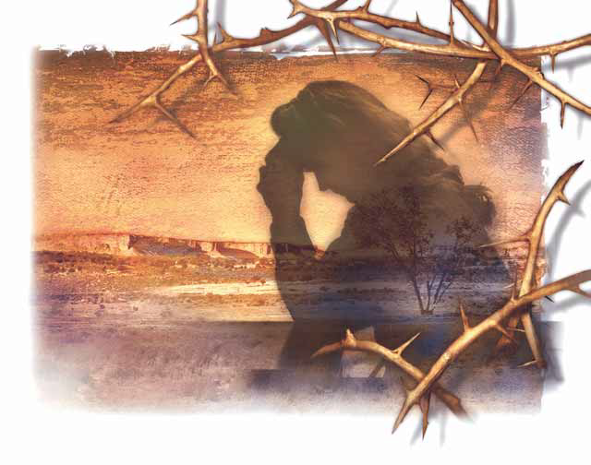
The stony ground represents those who receive the Word of God with joy, but do not believe deeply.
When they were tempted, they fall away because their belief of the Gospel is not strong.
The thorns are the cares and riches of this world that choke the Word of God.

Slide 11
The good, fertile land represents those who heard the Word of God and sent their roots deep into Gospel soil.
They seek to understand the Word of God and strive to follow Christ’s example.

Slide 12
The Meaning of the Sower Parable
Seeds | Gospel of Jesus Christ or the word of God
Soil | Hearts of those who hear the word
By the way side | Do not understand
Upon stony places | Hear but have no root; become offended easily
Among thorns | Choked by worldly cares and riches
Into good ground | Hear and understand
Fowls | Satan
Fruit | Good works
Enr. Act. #1

Slide 13
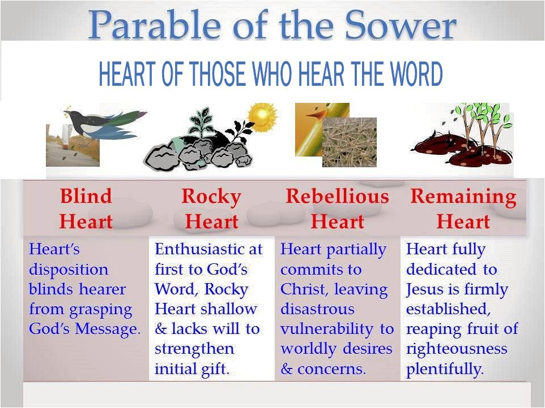

Slide 14
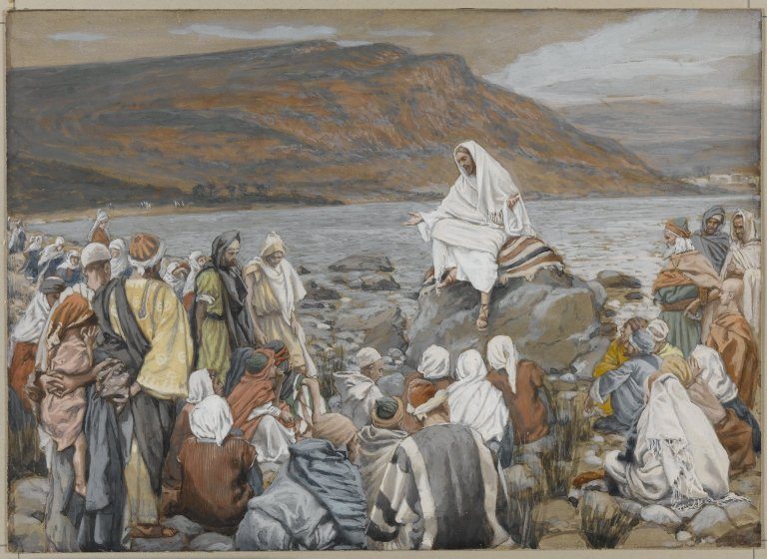
The Parable of the Wheat and Tares
One parable that Jesus taught while He was in Galilee was about wheat and tares (a kind of weed).

Slide 15
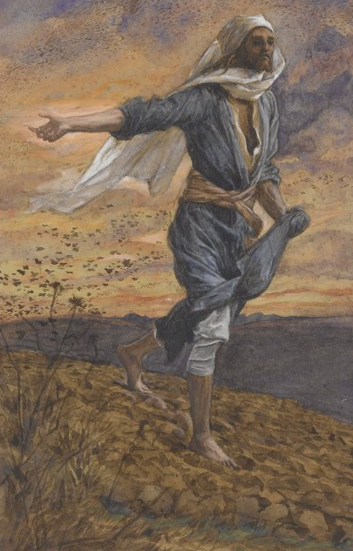
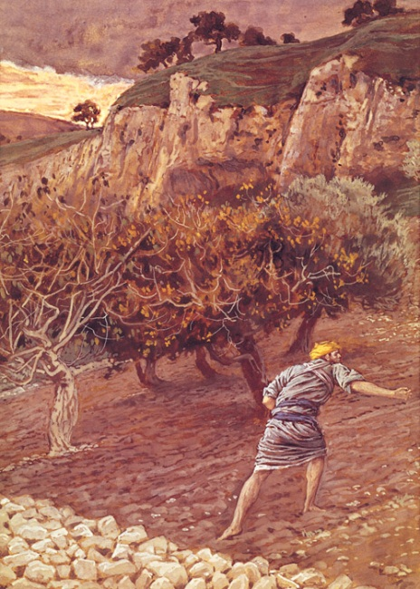
Jesus said that a man who had a field planted good wheat seed in it.
While he slept, someone came and planted tares in the same field.
Tares look a lot like wheat as they grow.

Slide 16
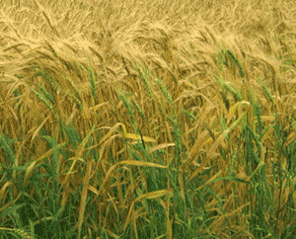
All the seeds started to grow, and blades of wheat and tares broke through the ground.
A worker in the field noticed the tares growing with the wheat.
He asked the owner about the tares.
The owner of the field said that an enemy must have planted the tares.

Slide 17
TARES or DARNEL
When you look up the word "Tares" on Wikipedia, it comes back with the equivalent plant named "Darnel. Darnel, which expresses has a characteristic of making one feel poisoned with drunkenness, and can cause death. The plant is mentioned in… the Parable of the Tares in the Gospel of Matthew."

Slide 18
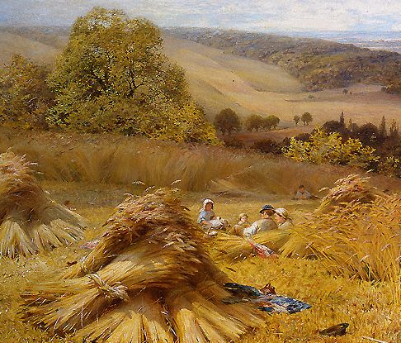
When the worker asked if the tares should be pulled up and destroyed, the owner said no.
If the tares were weeded out, He explained, a lot of the wheat would be destroyed, too, since they were growing side by side.

Slide 19
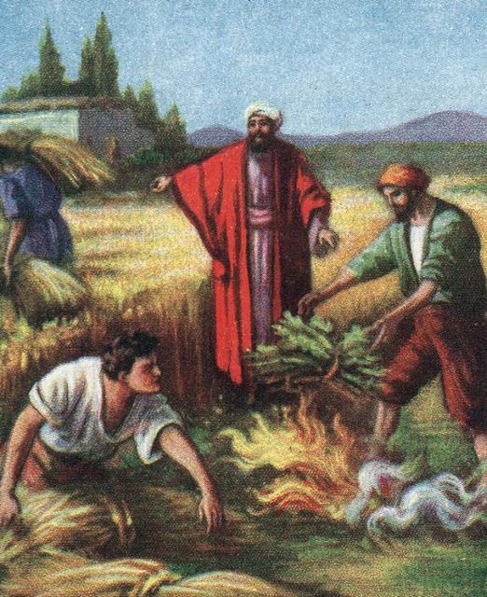
So the wheat and the tares were both allowed to grow until harvest time.
Then the owner told the reapers to first gather and store the wheat safely in the barn.
Gathering and sorting the Wheat from the Tares is simple enough. The Wheat has a brown flat gain head, and the Tares come up with flat black grain heads.

Slide 20
When Jesus’ disciples were alone with Him, they asked Him to explain the parable.
Jesus said that the sower of the good seed represented Himself and the Apostles; the field represented the world; the good seed, His righteous followers.

Slide 21
The tares represented those who follow Satan. Satan was the sower of the tares.
The harvest represented the end of the world, and the reapers represented angels.

Slide 22
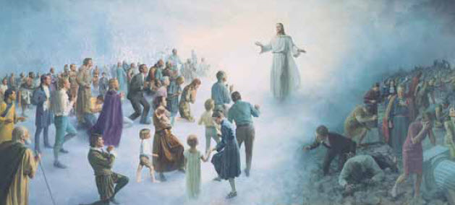
Right now good and bad people are allowed to “grow” together.
But at the end of the world, angels will separate the righteous from the unrighteous.

Slide 23
The unrighteous—those who have chosen to break the commandments—will be punished and will wail and gnash their teeth.

Slide 24
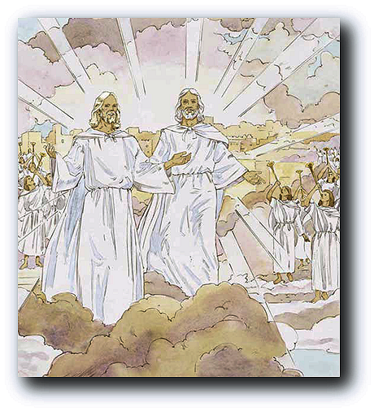
However, the righteous—those who have chosen to keep the commandments—will “shine forth as the sun in the kingdom of their Father” (Matthew 13:43).

Slide 25
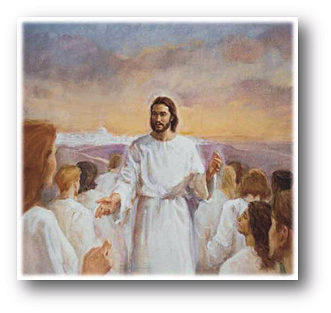
When we come to earth, we are given the freedom to choose between good and evil.
It is up to us to choose whether we will be like the wheat or the tares.

Slide 26
TARES or DARNEL
When you look up the word "Tares" on Wikipedia, it comes back with the equivalent plant named "Darnel. Darnel, which expresses a characteristic of making one feel poisoned with drunkenness, and can cause death.

Slide 27
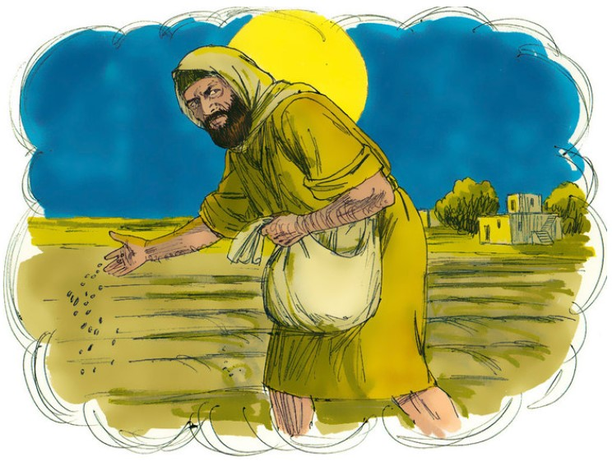
DARNEL
The Faussett Bible Cyclopedia states that "when mixed with wheat flour [it] causes dizziness, intoxication, paralysis, a general trembling, followed by inability to walk, hindered speech and vomiting.

Slide 28
Applications
In the end it’s about the quality of the harvest.
The roots of the tares can kill good wheat. They must stay strong it’s a struggle to live and survive.
The tares can be translated to “darnel,” which is a toxic poison.
The farmer must be aware of Satan’s attacks. He is always there. Be alert . . .DAILY!
The farmer always waits for the Harvest Season. This is God’s promise of a future judgment.

Slide 29
Applications
Only God can identify the real “Wheat” from those who are “tares.” Leave it to God!
One day Jesus will cast out all of the “causes,” of sin! (Matt. 13:41)
The good seed was hidden until the enemy came along. Be constantly in the WORD.
The enemy will always attack the workers of the farm. He will prowl like a lion. Attacks to others, may require us to fight as a team of believers.
One day there is a harvest and the “tares/darnel” will be destroyed.

Slide 30
Applications
In the end everything will be exposed.
Spiritual “discernment,” is needed to sort out the wheat from the tares. Depend upon God’s Spirit to help you discern the truth.
We are called to be witnesses, NOT lawyers, or judges. Be active as witnesses.
There will be counterfeit Christians and and false teachers. Let God be the judge. Be careful who you put in leadership/teacher positions.

Slide 31
Application
2Pe 3:9 The Lord is not slow to fulfill his promise as some count slowness, but is patient toward you, not wishing that any should perish, but that all should reach repentance.

Slide 32
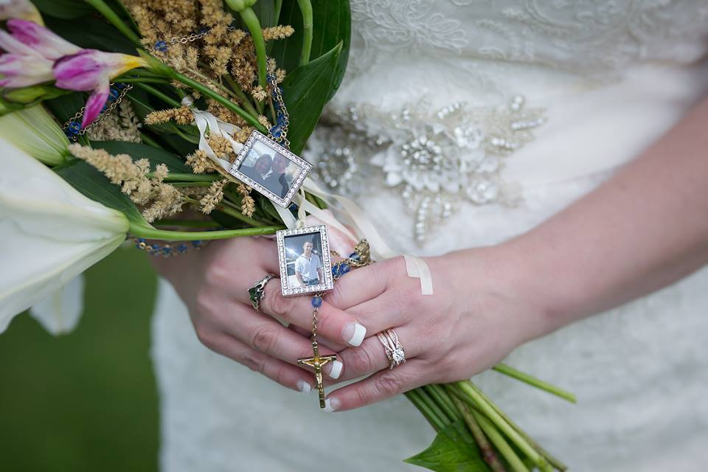
Becky Green of Wasilla, Alaska lost her son, Triston Green, in a car accident in 2015 when he was just 20 years old. In her wedding her flowers had pictures of him.

Slide 33
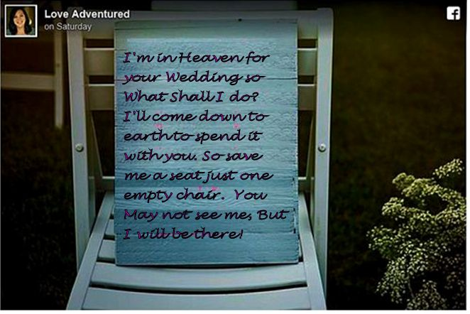
Friends set up a chair with a sign . . .

Slide 34
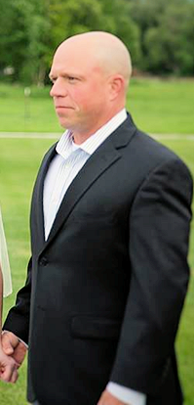
Kelly Turney, fiance’ wanted to make sure her son was as much a part of their wedding as possible.
Triston Green, her son, “donated the gift of life to five complete strangers through organ donation. It is no surprise that everyone who knew him said that he was their best friend. On that morning, five people gained a new best friend.”
Turney, surprised her by flying Jacob up to Alaska to stand in as a groomsmen, carrying Triston’s heart,”

Slide 35
Jacob Kilby received Triston’s donated heart
Jacob Kilby was born with Hypoplastic Left Heart Syndrome, a heart defect “where the left side of the heart does not fully develop for blood to flow through the heart.” He’d had four failed open heart surgeries by the age of two. Fortunately, a compatible heart was able to be transplanted to him just in time, but that heart started to weaken. By 2014, Kilby was on the organ donation list once again to receive a new heart. Now he has Triston’s.

Slide 36
Jacob Kilby received Triston’s donated heart
According to the U.S. Department of Health and Human Services, about 20 people in the U.S. die every single day waiting for an organ donation. There are approximately 119,000 people currently waiting for a lifesaving organ. One donor has the potential to save up to eight lives.

Slide 37
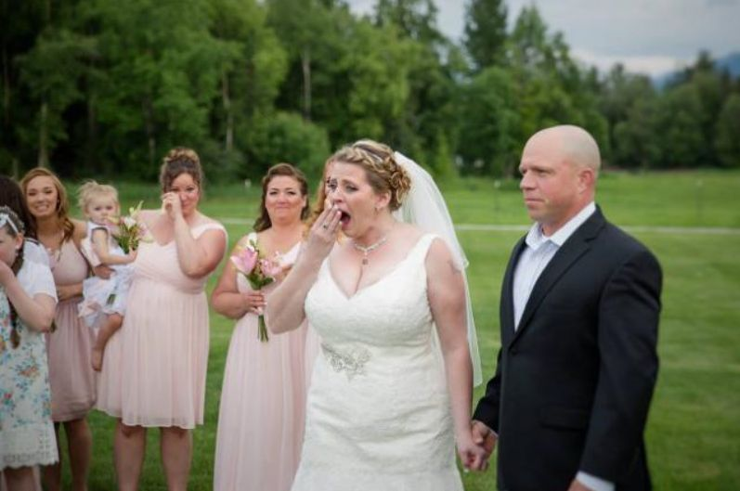
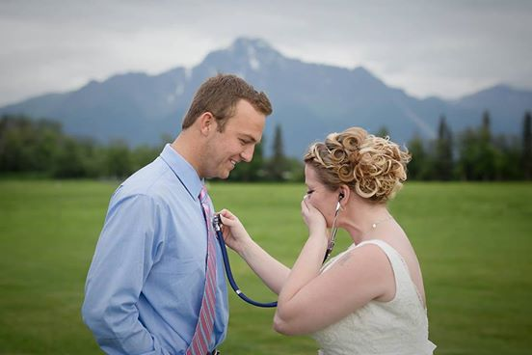
Kelly Turney, stopped the ceremony to introduce Jacob Kilby to Becky for the first time.”

Slide 38
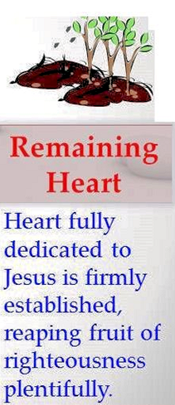
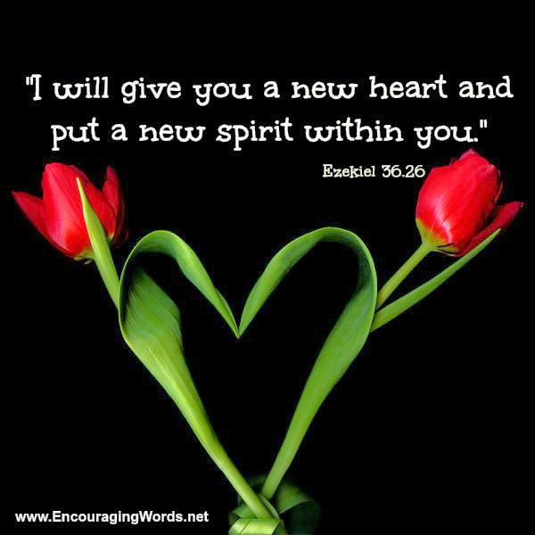

Slide 40


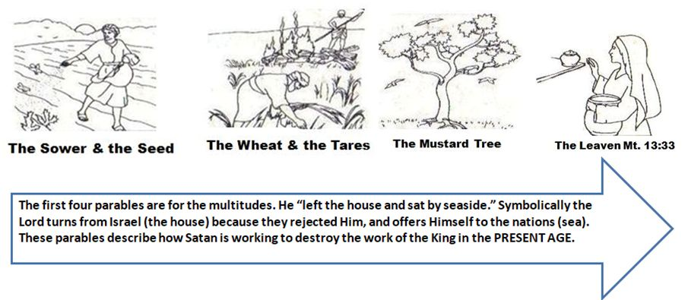

Slide 41
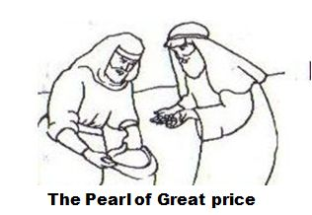
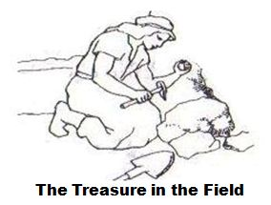
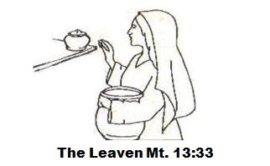
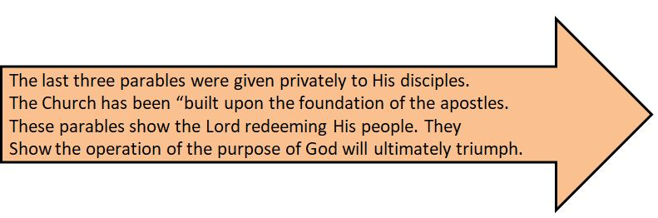


Slide 42
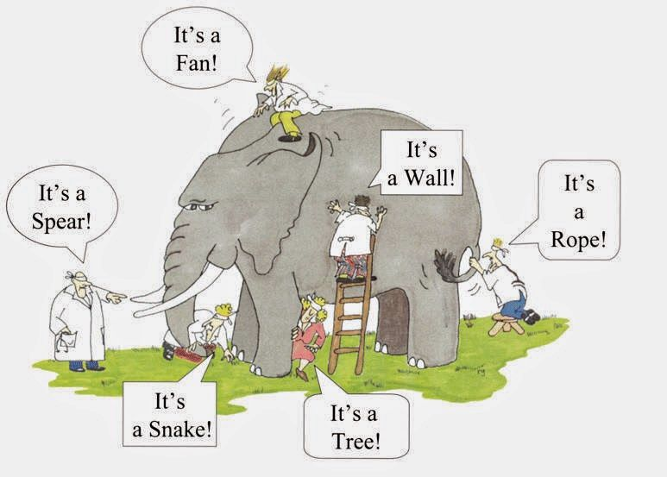
What is the “Kingdom of God?”

Slide 43
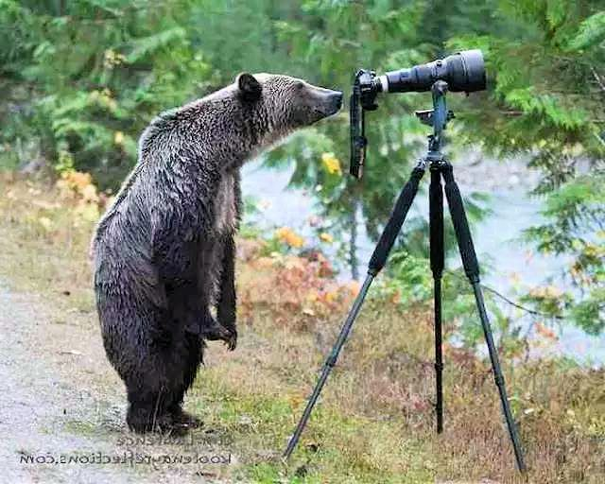
Next Week: Kingdom of God Bus Tour
2 Peter 3:9 The Lord is not slow to fulfill his promise as some count slowness, but is patient toward you, not wishing that any should perish, but that all should reach repentance.

Slide 44
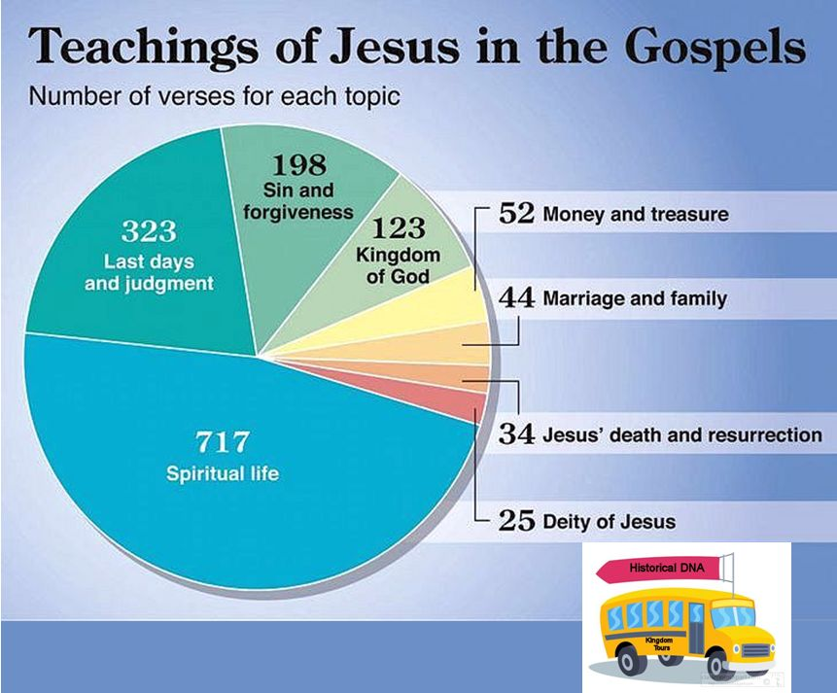

Slide 45
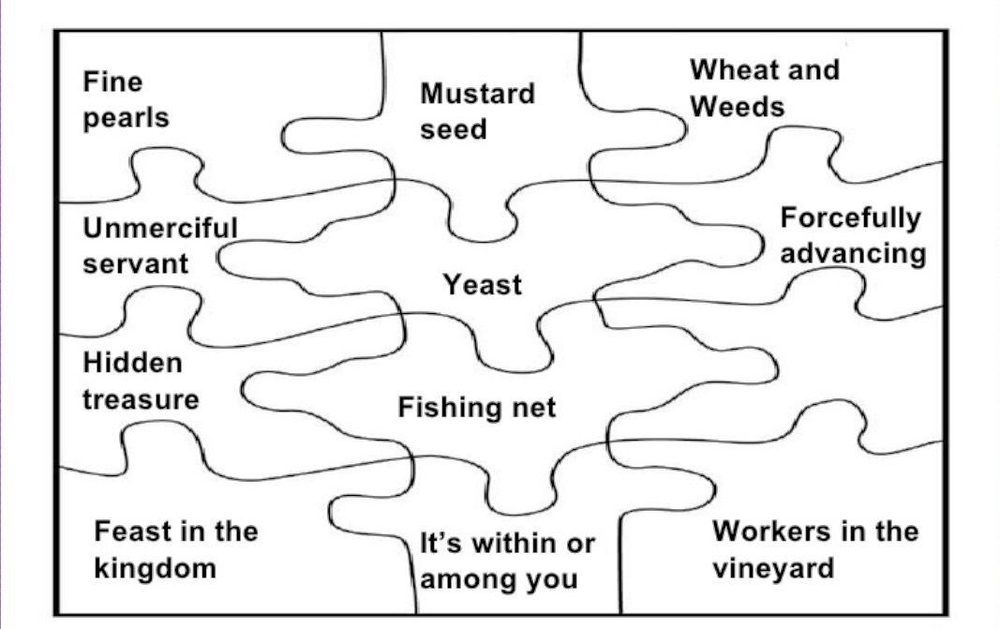
SECRETS OF THE KINGDOM
Notes:
Mat 13:10 Then the disciples came and said to him, "Why do you speak to them in parables?"
Mat 13:11 And he answered them, "To you it has been given to know the secrets of the kingdom of heaven, but to them it has not been given.

Slide 46
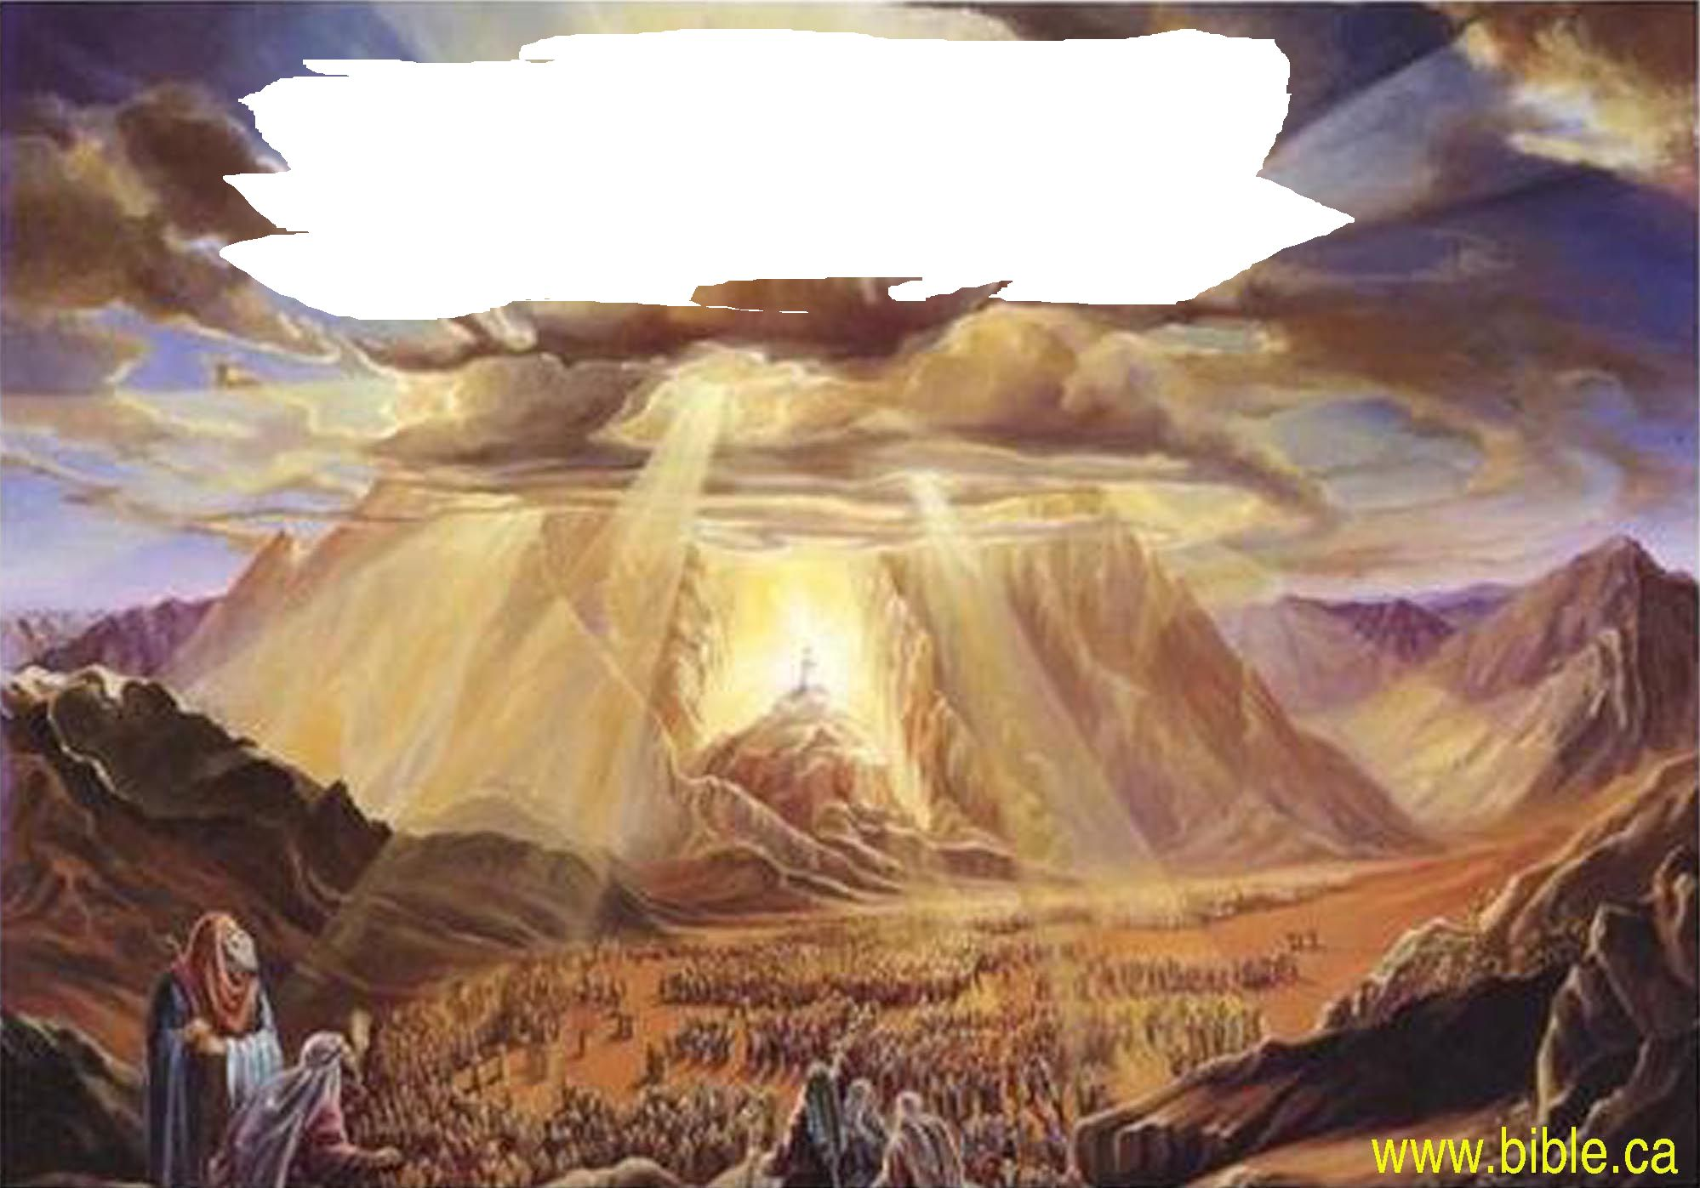
God's Holiness, His Righteousness
His Justice, His Covenant Promises
His Will, His Power
His Plan of Salvation, A New Creation
A New Community

