Slide 1
Breaking out
Matthew 11:2-17

Slide 2
Questions
Why is John the Baptist suddenly doubting Jesus? (v. 3)
Why are those in the kingdom of heaven greater than John the Baptist? (v. 11)
How can the kingdom of heaven experience violence? (v. 12)
How is the audience like “children in the marketplace”? (v. 16)

Slide 3
Why did John the Baptist Doubt?
Jesus’ Report | Reference
“The blind receive sight…” (Mt. 11:5) | “Then the eyes of the blind be opened…” (Isa. 35:5)
“..the lame walk…” (Mt. 11:5) | “Then will the lame leap like a deer…” (Isa. 35:6)
“…those who have leprosy are cured…” (Mt. 11:5) | “…the unclean will not journey on [the way]…” (Isa. 35:8)
“…the dead are raised…” (Mt. 11:5) | “But your dead will live, Lord; their bodies will rise…” (Isa. 26:19a)
“…the good news is preached to the poor.” (Mt. 11:5) | “…the Lord has anointed me to proclaim good news to the poor.” (Isa. 61:1a)

Slide 4
Possibility #1: Anticipation of Freedom
Jesus’ Report | Reference
(No Reference to Rescue) | “Be strong, do not fear; your God will come… He will come to save you.” (Isa. 35:4)
“The blind receive sight…” (Mt. 11:5) | “Then the eyes of the blind be opened…” (Isa. 35:5)
“..the lame walk…” (Mt. 11:5) | “Then will the lame leap like a deer…” (Isa. 35:6)
“…those who have leprosy are cured…” (Mt. 11:5) | “…the unclean will not journey on [the Way]…” (Isa. 35:8)
“…the dead are raised…” (Mt. 11:5) | “But your dead will live, Lord; their bodies will rise…” (Isa. 26:19a)
“…the good news is preached to the poor.” (Mt. 11:5) | “…the Lord has anointed me to proclaim good news to the poor.” (Isa. 61:1a)
(No Reference to Freeing the Prisoner) | “He has sent me…to proclaim freedom for the captives and release from darkness for the prisoners…” (Isa. 61:1b)

Slide 5
Possibility #2: Validation of Ministry
“Are you the one who was to come, or should we expect someone else?” (v. 3)
ἕτερον προσδοκῶμεν
heteron prosdokōmen
Heteron = Another, of a different type
Prosdokōmen = Wait, anticipate
“…or should we wait for someone different, as we have waited for You?”

Slide 6
1. Jesus GENTLY REBUKES John the Baptist (v. 2-6)
“Blessed is anyone who does not stumble on account of me.” (NIV 1984)
“Blessed is the man who does not fall away on account of me.” (NIV 2011)
“And blessed is the one who is not offended by me.” (ESV)

Slide 7
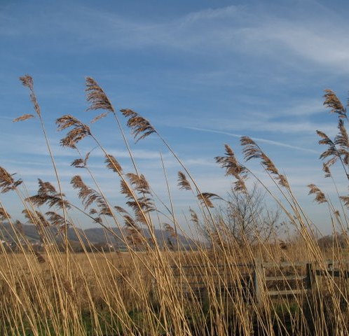
2. Jesus Defends John the Baptist (v. 7-10)
“What did you go out into the wilderness to see?”
“A reed swayed by the wind?” = someone easily swayed; not strong-willed

Slide 8
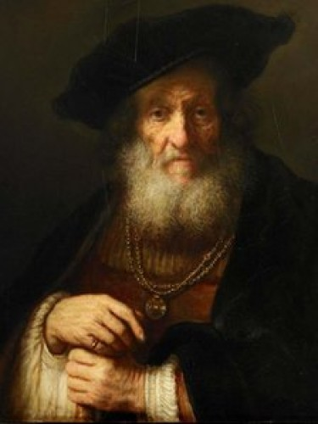
2. Jesus Defends John the Baptist (v. 7-10)
“What did you go out into the wilderness to see?”
“A man dressed in fine clothes?” = someone whose appeal is external only

Slide 9
2. Jesus Defends John the Baptist (v. 7-10)
“I will send my messenger, who will prepare your way before you.” (Mal. 3:1a)
“See, I will send the prophet Elijah to you before that great and dreadful day of the Lord comes. (Mal. 4:5)

Slide 10
2. Jesus Defends John the Baptist (v. 7-10)
“I tell you the truth: Among those born of women there has not risen anyone greater than John the Baptist…” (v. 11a)

Slide 11
Why are those in the kingdom of heaven greater than John the Baptist?
“… yet he who is least in the kingdom is greater than he.” (v. 11b)

Slide 12
How can the kingdom of heaven experience violence? (v. 12)
“From the days of John the Baptist until now the kingdom of heaven has suffered violence, and the violent take it by force.” (ESV)
“ And from the time John the Baptist began preaching until now, the Kingdom of Heaven has been forcefully advancing, and violent people are attacking it.” (NLT)
“From the days of John the Baptist until now, the kingdom of heaven has been suffering violence, and the violent have been seizing it by force.” (HCSB)
“From the days of John the Baptist until now the kingdom of heaven has been forcefully advancing, and forceful men lay hold of it.” (NIV 1984)

Slide 13
How can the kingdom of heaven experience violence? (v. 12)
“From the days of John the Baptist until now the kingdom of heaven has suffered violence, and the violent take it by force.” (ESV)
“From the days of John the Baptist until now the kingdom of heaven has been forcefully advancing, and forceful men lay hold of it.” (NIV 1984)
“ ἀπὸ δὲ τῶν ἡμερῶν Ἰωάννου τοῦ Βαπτιστοῦ ἕως ἄρτι ἡ βασιλεία τῶν οὐρανῶν βιάζεται, καὶ βιασταὶ ἁρπάζουσιν αὐτήν.”
Βιάζεται / βιασταὶ - biazetai / biastai = to force; inflict violence on

Slide 14
Possibility #1: Political Unrest
Arguments For:
John the Baptist is in prison
Zealots call for war against the Roman Empire
Arguments Against:
Jesus rarely commented on political matters, if at all
The kingdom of heaven is not physical (John 18:36)
“From the days of John the Baptist…” is a specific time frame reference

Slide 15
Possibility #2: Opposition to John’s Ministry
Arguments For:
Puts the kingdom of heaven back in context with John the Baptist
Correctly interprets the kingdom of heaven as non-political
Arguments Against:
Characterizes the kingdom of heaven as vulnerable, subjectable

Slide 16
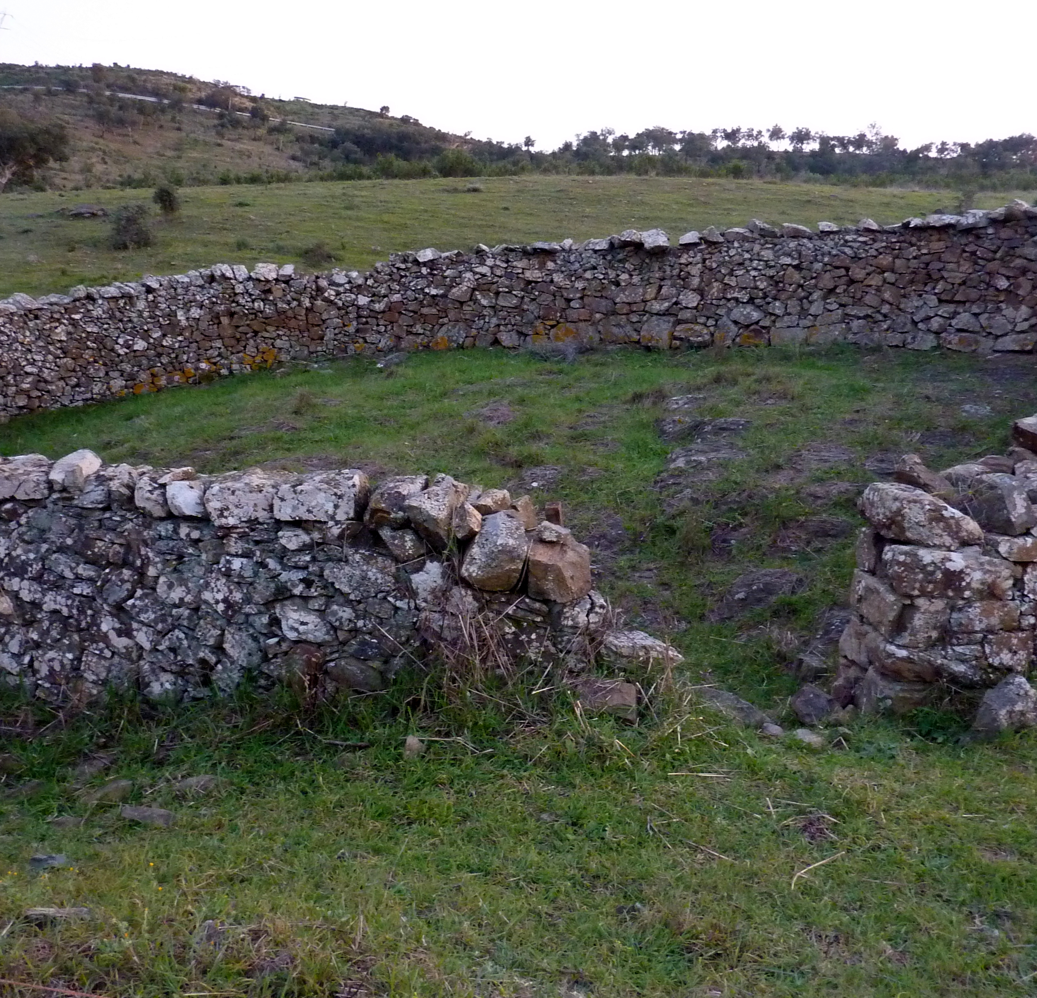
How can the kingdom of heaven experience violence? (v. 12)
¹² “I will surely gather all of you, Jacob; I will surely bring together the remnant of Israel. I will bring them together like sheep in a pen, like a flock in its pasture; the place will throng with people. ¹³ The One who breaks open the way will go up before them; they will break through the gate and go out. Their King will pass through before them, the Lord at their head.” (Micah 2:12-13)

Slide 17
Possibility #3: Fulfillment of Micah’s Prophecy
“From the days of John the Baptist until now the kingdom of heaven has been forcefully advancing, and forceful men lay hold of it.” (NIV 1984)
John the Baptist = “The Breaker”
Jesus = “The King”

Slide 18
3. Jesus Proclaims that the Kingdom of Heaven is Breaking Out (V. 11-15)

Slide 19
How is the audience like “children in the marketplace”? (v. 16)
¹⁶ To what can I compare this generation? They are like children sitting in the marketplaces and calling out to others,
¹⁷ “We played the flute for you, but you did not dance; we sang a dirge, but you did not mourn.” (Mt. 11:16-17)

Slide 20
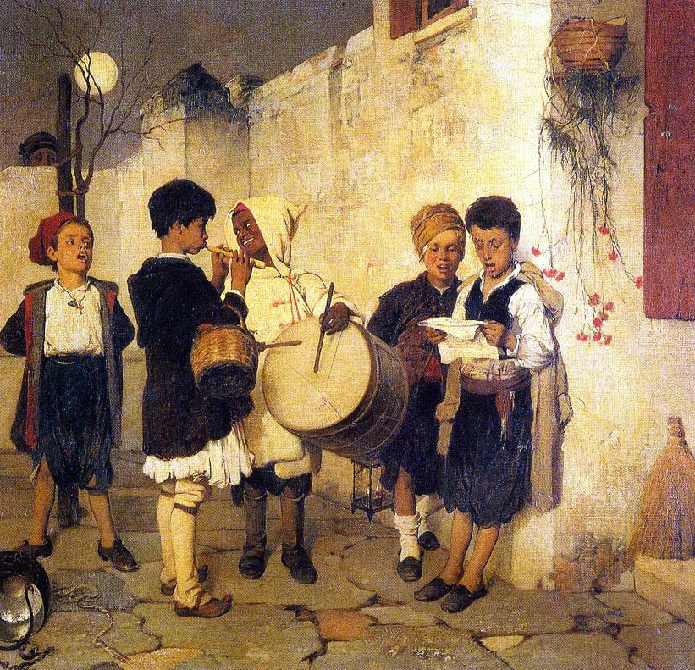
Possibility #1: Children’s Game
“We played the flute for you…” = Wedding Game
“We sang a dirge…” = Funeral Game

Slide 21
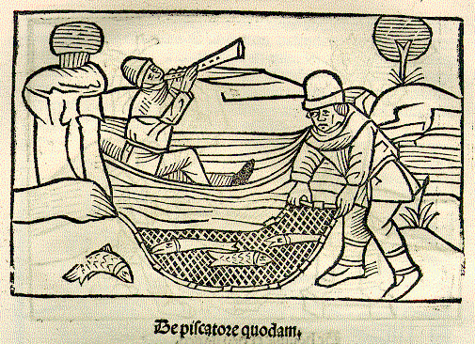
Possibility #2: The Fisherman and the Flute

Slide 22
4. Jesus Warns the People to be Aware (v. 16-17)

